Slide 1
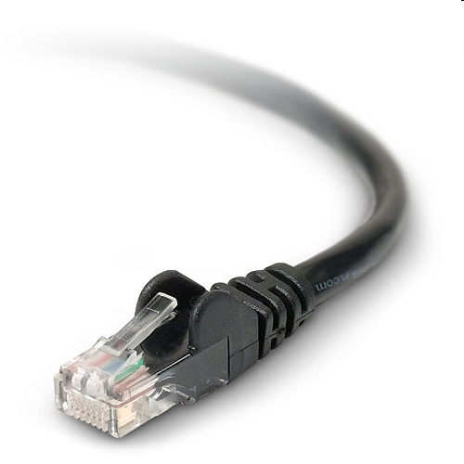
STM32 Connectivity Line Ethernet & TCP/IP introduction
Notes:
Good evening everyone, thanks for joining this presentation.
In the 4h of this presentation, I will focus on the Ethernet feature of the STM32 connectivity line and introduce the TCP-IP stack.

Slide 2
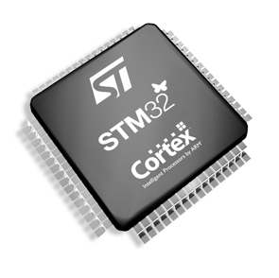
Content
STM32Fx07 Ethernet
Generic information about TCP-IP
Nichelite TCP-IP Stack
Application Examples
Notes:
We will start with the description of the Ethernet IP of the STM32F207, and present the Precision Time Protocol also called IEEE 1588.
Then we will go on with generic information about TCP-IP stack, its key protocols and also application layers protocols.
Then we will introduce the NicheLite TCP-IP stack from interniche. This is one software solution packaged by STMicroelectronics.
In the last part of this presentation I will provide some example of application, I will describe some HW configuration as well as a Software solution for each example.
ANIMATION
Let’s start with the hardware part with STM32F207 Ethernet.

Slide 3
The STM32Fx07 MAC block diagram
Configurable and flexible MAC 802.3
Support two industry standard interfaces for the PHY
Media Independent Interface (MII)
Reduced Media Independent Interface (RMII)
Integrated DMA controller
Hardware support of IEEE 1588
Ethernet wakeup event
STM32Fx07
AHB Bus
Ethernet
MAC
802.3
IEEE 1588
PHY
DMA
FIFO
TX
FIFO
RX
MII /
RMII
MDC / MDIO
Wake up event
Notes:
This is a simplified block diagram of the STM32F107 Ethernet IP, ---ANIMATION---, the core part is the MAC 803.2 part.
This MAC supports 2 standards to connect the PHY : ---ANIMATION---
MII interface (media independent interface)
Or the Reduced Media Independent interface that is using less pins but requires an higher input clock.
On the Block diagram we can see a MDC/MDIO connection between the MAC and the PHY, this allows the MAC to access the register of the PHY and configure it. It is a 2 signals connection :
The MDC is providing the clock
The MDIO is the data line.
---ANIMATION---
The MAC also have a integrated DMA controller, this controller is part of the Ethernet peripheral and allows flexible data transfer to/from the memory of the STM32. You see here that the Ethernet peripheral is connected on the high speed AHB bus for increased performances.
---ANIMATION---
The STM32 has hardware support for the IEEE1588, also called precision time protocol, I will introduce it in the next slide.
---ANIMATION---
The last feature presented on this diagram is the Wake Up event, the Ethernet IP can wake up the core and the other peripheral. upon reception of any Ethernet Frame or upon reception of a specific frame.
There are many other features to improve the performances of the Ethernet that are not described in this simplified diagram, such as advanced CRC features. I invite you to read the reference manual.

Slide 4

Precision Time Protocol (IEEE1588) : What is it
It is a protocol designed to synchronize real-time clocks of the devices of a network
Synchronization is done with the most accurate clock found in a packet-based network: called the Grand Master Clock.
Sub-µsecond
Detailed PTP description
09:10
09:00
09:01
09:00
09:00
GrandMaster Clock
09:00
09:05
09:00
09:30
09:00
Notes:
Now I will introduce the Precision Time Protocol or IEEE1588… What is it?
---ANIMATION---
Is it a protocol to synchronize devices on a network, in other words it allow the devices to share the same real-time clock.
---ANIMATION---
Here I have 5 devices on my network :
One at 9:00 sharp,
One a 9:05
9:10…
None of the devices have the same clock, this can be a big issue for some industrial applications. There are ways to synchronize devices, one is to include a GPS module in each device and they will all synchronize on the GPS clock. But this is an expensive solution that will not work indoor. There are other protocol like NTP (network time protocol) but not very accurate.
So how does it works?
---ANIMATION---
I have a grand Master clock ---ANIMATION--- the device on the left, and I want all the device share the same clock.
The precision time protocol can help you to do that, the master device will exchange several UDP frame with the other devices and each device will be able to compute its offset with the master clock and resynchronize itself continuously. Part of the protocol is implemented in software, the timestamp part of if is done in hardware.
---ANIMATION---
This with a sub-microsecond accuracy, less of a microsecond.
One comment, this PTP (precise time protocol) is a low cost way to have a very precise clock shared around your network, that’s it. This protocol does not guaranty a real-time delivery of the packets, for example, it will not garanty the delivery time of a TCP packet sent by your application.
It only keeps the devices’ clock synchronized, but it does it very well. ---ANIMATION---
Click on the detailed PTP description only if you have time to present it

Slide 5
Content
STM32Fx07 Ethernet
Generic information about TCP-IP
Nichelite TCP-IP Stack
Application Examples
Notes:
We will start with the description of the Ethernet IP of the STM32F207, and present the Precision Time Protocol also called IEEE 1588.
Then we will go on with generic information about TCP-IP stack, its key protocols and also application layers protocols.
Then we will introduce the NicheLite TCP-IP stack from interniche. This is one software solution packaged by STMicroelectronics.
In the last part of this presentation I will provide some example of application, I will describe some HW configuration as well as a Software solution for each example.
ANIMATION
Let’s start with the hardware part with STM32F207 Ethernet.

Slide 6
Generic information about TCP-IP
SMTP
?
?
FTP
BOOTP
?
DHCP
HTTP
?
POP3
?
IP
TFTP
?
SNMP
?
ICMP
PPP
?
DNS
?
ARP
Telnet
?
?
UDP
TCP
Notes:
We know, or have seen all these protocols, but :
what is the purpose of all theses protocols ?
What are the Key protocols ?
Some protocols are not known, but aren’t they important protocols as well?

Slide 7
TCP-IP : A layered protocol stack
Application
Layer
The main interface for the user.
Higher level protocols
Transport
Layer
End-to-end connections (UDP and TCP)
Ensure reliability (TCP)
Internet
Layer
Intra & Inter-Network communication
no guaranty of delivery
Data link
Layer
Intra-Network communication
Transport data on the physical support
Notes:
TCP-IP is a layered protocol stack, each layer providing different services.
---ANIMATION---
I will start with the application layer, ---ANIMATION--- user application are usually at this layer, high level protocols such as email protocols are in this layer as well.
---ANIMATION---
The second layer is the Transport Layer, ---ANIMATION--- it provides end to end connection services. For some of the protocols of this layer such as TCP will ensure the reliability of the connection, other protocols such as UDP don’t ensure the reliability of the connection. We will come back on this difference later on.
---ANIMATION---
Below the Transport layer you will find the internet layer that provides an intra-network and inter-network communication service. ---ANIMATION--- What is the difference between intra and inter network communication :
An intra-network communication is a communication of devices connected on a Hub for example
While an example of inter-network communication is a communication between devices located in 2 different companies, information sent by the first device need to go through routers to reach the second device
One of the Key information here is that the Internet layer does not provide any guaranty of delivery, it is a best effort delivery, we will come back on this later.
Finally the Datalink layer, ---ANIMATION--- this part is mainly implemented by hardware, the MAC and the PHY are inside this layer, the low level Ethernet driver as well. ---ANIMATION---This layer provides intra-network communication service and physical transport of the information (electrical signal). The STM32 and its Ethernet peripheral is in side this Datalink layer.
There are 4 layers in the TCP-IP stack, we will see later in the presentation where are the protocols located in these layers architecture.

Slide 8
TCP-IP : Encapsulation
User Data
TFTP
User Data
UDP
Checksum
Port Nb
TFTP Header
User Data
IP
Checksum
IP Address
UDP Header
TFTP Header
User Data
ETHERNET
Checksum
IP Header
UDP Header
TFTP Header
User Data
MAC Address
Ethernet Header
IP Header
UDP Header
TFTP Header
User Data
Ethernet Trailer
Notes:
Before introducing the protocols, I would like to present another key notion of software stacks : the encapsulation.
In this example I want to send user data over the network using the TFTP protocol.
A simple description of encapsulation is :
---ANIMATION--- I have user data to send
---ANIMATION--- I put the user data into a TFTP datagram (like an enveloppe)
---ANIMATION--- I then put the TFTP protocol into an UDP datagram
---ANIMATION--- The UDP protocol is then put into an IP datagram
---ANIMATION--- The IP protocol is the put into an Ethernet frame
---ANIMATION--- The Ethernet frame is then sent over the network
Practically this encapsulation is performed by :
---ANIMATION--- taking my user data
---ANIMATION--- Adding a TFTP header to the user data to form a TFTP datagram
---ANIMATION--- Adding a UDP header to the TFTP datagram to form an UDP datagram
---ANIMATION--- Adding a IP header to the UDP datagram to form an IP datagram
---ANIMATION--- Adding a Ethernet header and a Ethernet trailer IP datagram to form an Ethernet Frame
But then why do I need so many “envelopes” …
Because I have different information in each header :
The TFTP header will contain some commands specific to the TFTP protocol
---ANIMATION--- The UDP header will contain some information like a UDP port used for the end to end connection and a checksum. You can see that the UDP checksum is computed on the header and the data (the red rectangle)
---ANIMATION--- The IP header contains the IP address used to identify the destination device and a checksum. This checksum covers only the header
---ANIMATION--- Then the Ethernet header contains the MAC address of the destination device and the Ethernet trailer contains information on the header and the IP datagram
---ANIMATION--- In this simplified diagram I show only some information included in the headers. Each header contains more information than shown here.

Slide 9

TCP-IP : Key Protocols
IP
Transport Layer
I want to
send data to
127.127.127.127
IP
Ethernet
Checksum
MAC Address
TCP
UDP
I want to send a datagram on the port #
IP
UDP
UDP
Checksum
Internet Layer
IP Address
IP
I want to send data in a reliable way
on the port #
IP
TCP
TCP
Checksum
IP address
Datalink Layer
Ethernet
STM32Fx07
Click on the “letter” to get a detailed description
PHY
Notes:
Here I will introduce the TCP-IP key protocols.
I will change my approach from a top to bottom approach to a bottom up approach :
Her you can see the lower three layer described previously
The datalink layer
The internet layer
And the Transport layer
---ANIMATION--- The STM32Fx07 and the PHY are located in the datalink layer.
---ANIMATION--- The first protocol I will describe is the IP (Internet Protocol), Its purpose is to send data to another device identified by its IP address, or receive data from it. Here you can see “I want to send data to 127.127.127.127” .
---ANIMATION--- As seen before, the IP datagram is encapsulated in a Ethernet frame. IP means internet protocol and is located in…. ---ANIMATION--- The internet layer.
Let’s have a look to the characteristics of the IP protocol (click on the IP letter)
---ANIMATION--- The second protocol I will describe is UDP (User Datagram Protocol) Its purpose is to send data to send datagrams to another device. The UDP header conatins a port number to better identify the receiver, Here you can see “I want to send a datagram on the port #” .
---ANIMATION--- As seen before, the UDP datagram is encapsulated in an IP frame
--- analogy ---
To explain the port number I will make an analogy, if I send a letter to my friends house I will need to use my friends address, here it is the IP address. But what if I want my friend to read it and not his father, I need to write my friend’s name on the envelope as well. The port number is like the name of the application I want to send the data to. On a device there can be many application, the port number is here to help identify which application on this device
---ANIMATION--- You can see that the UDP relies on IP
Let’s have a look to the characteristics of the UDP protocol (click on the UDP letter)
---ANIMATION--- The third protocol I will describe is TCP (Transmission Control Protocol), Its purpose is to send data to send datagrams to another device in a reliable way. The TCP header contains a port number to better identify the receiver, Here you can see “I want to send data in a reliable way on the port #” .
---ANIMATION--- As seen before, the TCP datagram is encapsulated in an IP frame
--- analogy ---
In the previous analogy, I wanted to send a letter to my friend, but I had no way to make sure that my friends received it, indeed his father may have lost it… with the TCP the connection is reliable, the protocol will first set up a connection, it like giving a phone call to my friend and tell him I will send you one letter, my friends will be able to tell me if he received it or not… TCP is a reliable connection
---ANIMATION--- You can see that the TCP relies on IP
Let’s have a look to the characteristics of the TCP protocol (click on the TCP letter)
---ANIMATION--- as mentioned earlier these are key protocols of the TCP IP stack
---ANIMATION---

Slide 10

TCP-IP : Key Protocols
Transport Layer
Who knows 127.127.127.127’s MAC address?
ARP
ARP
Ethernet
TCP
UDP
Checksum
FF.FF.FF.FF.FF.FF
Internet Layer
I send or receive queries or error messages
IP
ICMP
ICMP
Checksum
PING 127.127.127.127
IP Address
ICMP
IP
ARP
Click on the “letter” to get a detailed description
Datalink Layer
ETHERNET
Ethernet
STM32F107
Checksum
?? MAC Address ??
PHY
Notes:
Here I will introduce 2 key protocols of the stack that are less known.
First the ARP, meaning Address Resolution Protocol. ---ANIMATION--- when encapsulating the IP datagram in an Ethernet frame, you need to know the MAC address of your destination ---ANIMATION--- . To learn the MAC address, the stack will use the ARP protocol. Here you can see “Who knows 127.127.127.127’s MAC address? “---ANIMATION--- This protocol relies on Ethernet and is broadcasted on the network (FF.FF.FF.FF.FF.FF)
-ANIMATION--- The next less known protocol is ICMP, Internet Control Message Protocol, -ANIMATION--- the ping function is using this protocol. It allows one device to send messages on the network, messages can be queries or error messages. For the Ping function, the ICMP Echo Request is used, this request is answered by a Echo Reply if the target device is reachable. -ANIMATION--- ICMP is at the Internet layer and relies on the IP protocol
--- analogy ---
-ANIMATION--- This protocol is like the traffic lights of internet.
-ANIMATION---
-ANIMATION---

Slide 11


TCP-IP : Key Application layer protocols
Application Layer
I want to get an
IP address ?
BOOTP
DHCP/
BOOTP
BOOTP
UDP
Checksum
DHCP
DNS
DHCP
Ports 67/68
Transport Layer
TCP
UDP
What is the IP address of www.st.com ?
DNS
UDP (TCP)
DNS
Checksum
Port 53
Internet Layer
ICMP
IP
Click on the “letter” to get a detailed description
ARP
Datalink Layer
Ethernet
STM32F107
PHY
Notes:
I will introduce some Key layer application protocols
-ANIMATION--- The first one is well known, it is DHCP Dynamic Host Configuration Protocol, -ANIMATION--- this protocol relying on UDP allows a device with a DHCP client to retrieve an IP address from a configuration server. The BOOTP (bootstrap protocol) be offers the same services but is an older protocol mainly replaced by DHCP.
-ANIMATION---
The second protocol is the DNS, -ANIMATION--- DNS means Domain Name Service. It is the Phone Book of internet that allows to retrieve the IP address of a device knowing its registered name. -ANIMATION--- For example you know www.st.com, a request to the DNS server will reply you the IP address of ST portal.
-ANIMATION---
-ANIMATION---

Slide 12





Application layer protocols
Email
World Wide Web
I want to send an email
TCP
SMTP
SMTP
Checksum
I want this resource.
Port 25
HTTP
HTTP
TCP
Checksum
Port 80
I want to get my emails.
POP3
POP3
TCP
Checksum
Port 110
Login :
_
Terminal connection
I want a terminal connection.
TCP
Telnet
Telnet
Files Transfer
Checksum
Port 23
I want to transfer files.
TFTP
TFTP
UDP
Checksum
Network Management
Port 69
I want to manage my network.
I want to transfer files
UDP
SNMP
FTP
FTP
SNMP
TCP
Checksum
Checksum
Ports 161/162
Ports 20/21
Notes:
This slide summarize the main application protocols and their function :
-ANIMATION--- World Wide Web
-ANIMATION--- HTTP (HyperText Transfer Protocol) use to get resources on the web, usually html pages
-ANIMATION--- Terminal connection :
---ANIMATION--- Telnet is use to emulate a terminal connection on internet
---ANIMATION--- Network Management
---ANIMATION--- SNMP (Simple Network Management Protocol) is a framework to help manage our growing networks
---ANIMATION--- Email
---ANIMATION--- SMTP (Simple Mail Transfer Protocol) is used to send emails
---ANIMATION--- POP3 (Post Office Protocol version 3) is used to retrieve emails from a server it as no sending feature.
---ANIMATION--- File transfer
---ANIMATION--- TFTP (Trivial File Transfer Protocol)
---ANIMATION--- FTP (File Transfer Protocol)
these are 2 protocols user for file transfer, TFTP uses UDP and has its own mechanism to ensure the reliability of the connection, FTP is build on top TCP and uses the TCP reliability.

Slide 13
Application layer protocols
World Wide Web
Application Layer
email
Other
Domain Names
SMTP
POP3
Telnet
DNS (c)
Configuration
File Transfer
WWW
File Transfer
Network mgt
BOOTP
HTTP
FTP
TFTP
SNMP
DHCP (c)
Email
Transport Layer
TCP
UDP
Internet Layer
ICMP
IP
Login :
_
Terminal
connection
ARP
Datalink Layer
Ethernet
STM32F107
Network
Management
PHY
Notes:
Here are all these protocols shown in their relative layers.
---ANIMATION--- ….. ---ANIMATION---

Slide 14
Content
STM32Fx07 Ethernet
Generic information about TCP-IP
Nichelite TCP-IP Stack
Application Examples
Notes:
I will now present one of the TCP-IP solution available on the STM32 : Nichelite TCP-IP

Slide 15
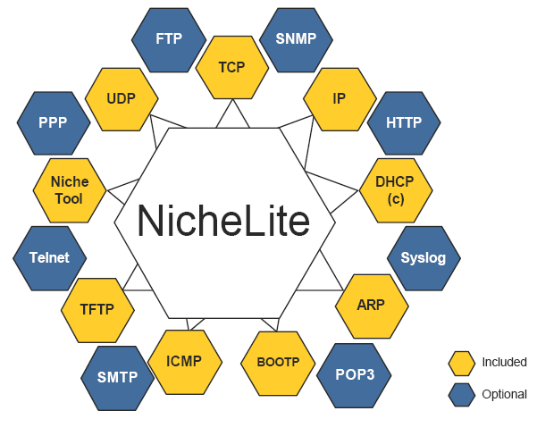
NicheLite from Interniche
Free Package from ST Source code available
Webserver Demo
Domain Names
Configuration
HTTP demo
DNS (c)
DHCP (c)
TCP / UDP demo
BOOTP
TCP client / server demo
UDP client / server demo
File Transfer
TFTP
TCP
UDP
ICMP
IP
Included
Optional
ARP
Others
Ethernet
STM32F107
Demos
Nichetool
PHY
Other solutions
Notes:
Nichelite is a TCP IP stack from a US company called interniche.
---ANIMATION--- in the block diagram below you see that the implementation from Interniche is flexible and have many modules.
---ANIMATION--- The yellow boxes are the modules included in the free package from ST. you will find here all the Key protocols of the stack.
In addition to theses free modules there are some demos included :
---ANIMATION--- an HTTP simple application ( without CGI)
---ANIMATION---
---ANIMATION--- a UDP client server demo
---ANIMATION--- a TCP client server demo
---ANIMATION---

Slide 16
NicheLite from Interniche
Free Package from ST Source code available
See Application Note AN3000 on our website for a detailed description of the Package
www.st.com/stm32
Webserver Demo
Domain Names
Configuration
HTTP demo
DNS (c)
DHCP (c)
TCP / UDP demo
BOOTP
TCP client / server demo
UDP client / server demo
File Transfer
TFTP
TCP
UDP
ICMP
IP
Included
Optional
ARP
Others
Ethernet
STM32F107
Demos
Nichetool
PHY
Other solutions
Notes:
You will find the link to download the package on our ST website : www.st.com/stm32
You will find as well an application note : AN3000 that contains :
An introduction to TCP-IP
A presentation of the Nichelite
Some debugging tips
A detailed description of the demos provided in the package

Slide 17
Content
STM32Fx07 Ethernet
Generic information about TCP-IP
Nichelite TCP-IP Stack
Application Examples
Notes:
In the coming part I will present 2 examples each time I will give some inputs on the Hardware and Software parts.

Slide 18
Example 1 : User defined protocol over TCP-IP
Hardware Requirements
Use a MII PHY already qualified by customer
Minimize the BOM cost
Software Requirements
The customer has its own protocol
Data is similar a stream of bytes :
Lost packets need to be resent
Packets need to be ordered
Lost data / data reordering is not handled by the protocol
User defined
My own
Protocol
TCP
Checksum
Notes:
Here is an example how to implement a user define protocol on top of TCP-IP
---ANIMATION--- Here are the Hardware Requirement :
---ANIMATION--- For this application the customer already has a qualified MII PHY and wants to use it for this application
---ANIMATION--- The customer want to minimize the BOM cost
---ANIMATION--- The Software requirements :
---ANIMATION--- As mentioned in the title, the customer has its own protocol and want to implement it on top of TCP-IP
---ANIMATION--- This protocol need to send data in a “stream like” way
This means that all the data need to arrive at the destination is the same order and data cannot be lost
---ANIMATION--- The user protocol is currently not handling the loss of data or reordering of the data. This means that the reliability has to be ensure by the lower protocols, ---ANIMATION--- in other words the TCP protocol is the most suitable transport layer protocol to use here.

Slide 19
Example 1 : Ethernet Block Diagram
STM32F107
Hardware Example
Other configurations
can be used as well
Ethernet
MAC 10/100
MII
PHY
15 pins
MII+MDC
= 17 pins
MDC/MDIO
2 pins
XTAL
25MHz
PLL
HCLK
OSC
XT1
25MHz
25MHz
One 25Mhz external crystal (internal oscillator)
MII interface
15 pins for the communication between the MAC & PHY
2 pins for the MDC / MDIO (to access PHY registers)
Notes:
---ANIMATION--- Here is a example of block diagram that can be used for this application
---ANIMATION--- Only one 25Mhz crystal is required here, reducing the BOM cost, the 25Mhz generated by the internal oscillator is output on the MCO GPIO and provided to the PHY
---ANIMATION--- Here the MII interface requires 17pins :
---ANIMATION--- 15 pins for the data transmission between the MAC & PHY
---ANIMATION--- 2 pins for the PHY configuration
---ANIMATION--- This is an example, other configuration can be used as well.

Slide 20
Example 1 : user defined protocol over TCP-IP
TCP client / server Application
Domain Names
Configuration
DNS (c)
DHCP (c)
TCP
TCP
UDP
IP
ICMP
IP
ARP
ARP
Included
Included
Ethernet
STM32F107
Ethernet
STM32F107
Based on demos
PHY
PHY
Notes:
A few words on the software part :
---ANIMATION--- The customer is starting from the Nichelite package for STM32 downloaded from our website :
---ANIMATION--- using the TCP-Client server demo to build his application
---ANIMATION--- then you see that all the protocol requires are already in the package : TCP
---ANIMATION--- IP
---ANIMATION--- ARP
---ANIMATION--- an the STM32
---ANIMATION--- for both sending and receiving frames.

Slide 21
Example 2 : Firmware upgrade
Hardware Requirements
Use RMII to optimize the GPIO usage
Reduce the BOM cost
Software Requirements
Need a commercial solution
Need a cost effective solution
Need the source code
Using a simple protocol
Reliable protocol
TFTP
I want to transfer files.
TFTP
UDP
Checksum
Port 69
Included
Notes:
Here is an example how to add a device firmware upgrade to your ethernet enabled application
---ANIMATION--- Here are the Hardware Requirement :
---ANIMATION--- For this application the customer wants to use an RMII PHY to reduce the GPIO count
---ANIMATION--- The customer want to minimize the BOM cost
---ANIMATION--- The Software requirements :
---ANIMATION--- the customer wants a commercial solution (no open source)
---ANIMATION--- he needs a cost effective solution
---ANIMATION--- The customer engineers require the source code of the stack
---ANIMATION--- The Nichelite Package is a good match
A few words about the protocol,
---ANIMATION--- the engineers want a simple protocol
---ANIMATION--- and for sure it as to be reliable
---ANIMATION--- The TFTP protocol already included in the package is a good match
---ANIMATION--- while relying on UDP this protocol implement a simple AND RELIABLE way to transfer files.

Slide 22
Example 2 :Ethernet Block Diagram
RMII interface ( RMII + MDC/MDIO = 9 pins)
One 25Mhz external crystal
Or one 50Mhz external oscillator
Hardware Examples
Other configurations
can be used as well
Ethernet
MAC 10/100
MII
7 pins
RMII
+MDC
= 9 pins
MDC/MDIO
HCLK
RMII_REF_CLK
PHY
RMII +
XTAL
25MHz
50MHz
OSC
PLLs
XT1/XT2
50MHz
PHY_CLK
50MHz
RMII_REF_CLK
PHY
RMII +
OSC
50MHz
PLL
HCLK
XT1
PHY_CLK
50MHz
Notes:
---ANIMATION--- Here is a example of block diagram that can be used for this application
---ANIMATION--- Here the RMII interface requires 9 pins :
---ANIMATION--- 9 pins for the data transmission between the MAC & PHY
---ANIMATION--- 2 pins for the PHY configuration
---ANIMATION--- A first option is to use only one 25Mhz crystal is required here, reducing the BOM cost, the 25Mhz generated by the internal oscillator goes through a PLL to output the 50Mhz clock required by the MAC and the PHY
---ANIMATION--- A second option is to use only one 50Mhz oscillator used by the MCU, the MAC and the PHY
---ANIMATION--- This is an example, other configuration can be used as well.

Slide 23
Example 2 : Firmware upgrade
TFTP Upgrade Application
File Transfer
Domain Names
Configuration
File Transfer
TFTP
DNS (c)
DHCP (c)
TFTP
TCP
UDP
UDP
IP
ICMP
IP
ARP
ARP
Included
Included
Ethernet
Ethernet
STM32F107
STM32F107
PHY
Demo under development
PHY
Notes:
A few words on the software part :
---ANIMATION--- The customer is starting from the Nichelite package for STM32 downloaded from our website.
---ANIMATION--- A TFTP demo is under development
---ANIMATION--- then you see that all the protocol requires are already in the package : TFTP
---ANIMATION--- UDP
---ANIMATION--- IP
---ANIMATION--- ARP
---ANIMATION--- an the STM32
---ANIMATION--- for both sending and receiving frames.

Slide 24
Summary
The STM32Fx07 is a product with advanced features
IEEE1588 support
MAC IP designed for performances
The STM32Fx07 is a flexible product :
RMII and MII connection available on all the packages
The customer can use his prefered PHY
Minimum external HW required
ST offers a effective Hardware & Software solution
NicheLite stack available for download with the Key Protocols and demo to start quickly
Source code of the stack provided
www.st.com/stm32
Notes:
Here is a summary of this presentation

Slide 25
Hands On
Ensure you have:
All examples in the github repository> www.github.com/Montanari9
USB Cable
STM32F429 NUCLEO KIT
Ethernet cable crossed
Notes:
Plan was changed and flash drive will be handed out at the time when the tools installation begins, around slide 45.

Slide 26
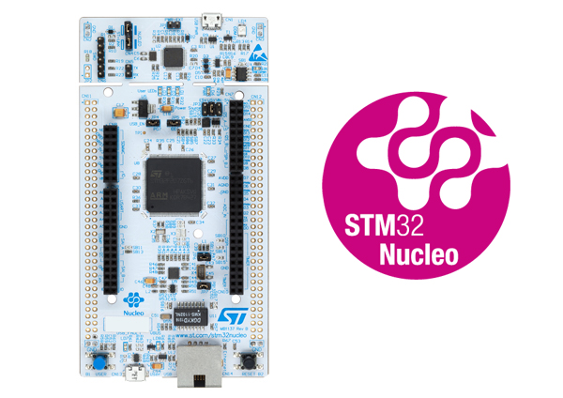
Getting to know our Hardware
The kit that will use in the hands-on examples is the
NUCLEO-F429ZI

Slide 27
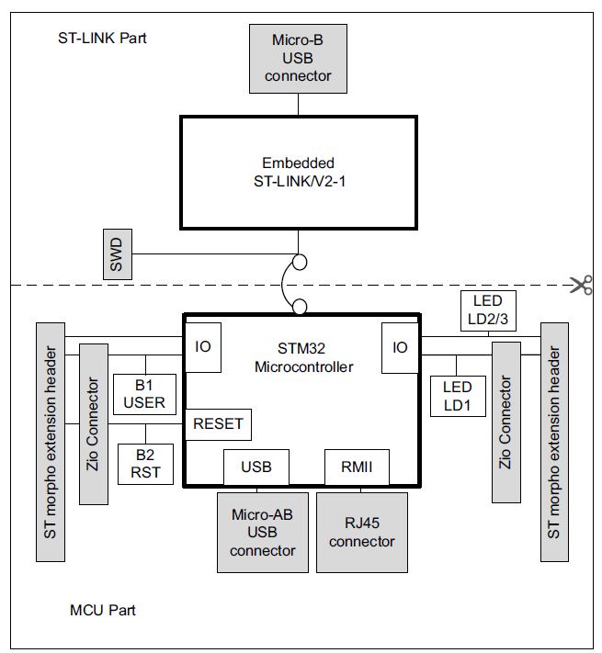
Getting to know our Hardware
This is the major block diagram for the eval kit

Slide 28
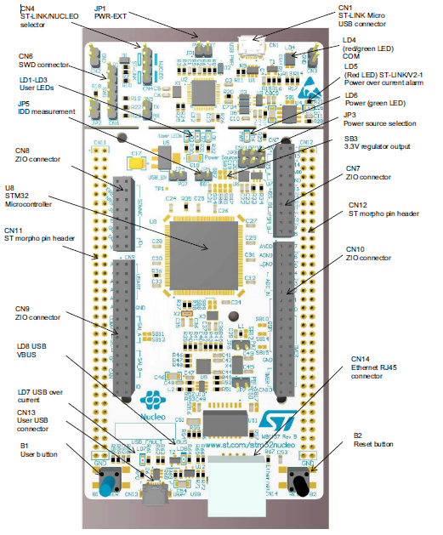
Getting to know your hardware

Slide 29
Ethernet PHY and pins
The STM32 Nucleo-144 board supports 10 M/100 M Ethernet communication by a PHY LAN8742A-CZ-TR (U9) and RJ45 connector (CN14).
Ethernet PHY is connected to the STM32 microcontroller via the RMII interface. 50 MHz clock for the STM32 microcontroller is generated by the PHY RMII_REF_CLK.
JP6 and JP7 must be closed when using Ethernet.

Slide 30
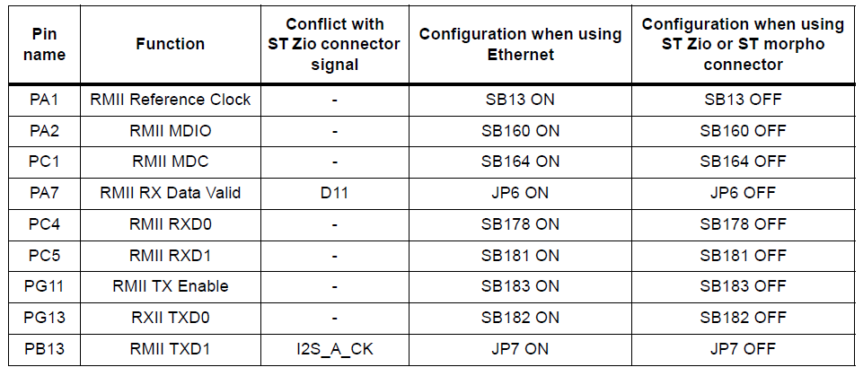
Ethernet PHY and pins
The PINS used are described in the table below:

Slide 31
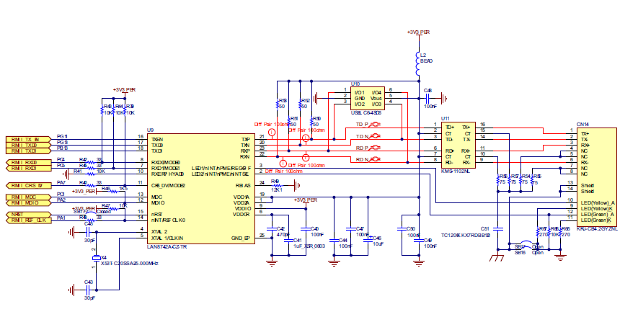
Ethernet PHY and pins

Slide 32



Software Packages
These are the major building blocks for the Ethernet Application to run:
STM32Cube
LwIP – 1.5.0
FreeRTOS
Optional

Slide 33
CubeMX Overview
Hardware: All STM32
HAL Layer
Middleware

Slide 34
Middleware: LwIP
TCP/IP stack description:
IPv4 and IPv6 (Internet Protocol v4 and v6)
ICMP (Internet Control Message Protocol) for network maintenance and debugging
IGMP (Internet Group Management Protocol) for multicast traffic management
UDP (User Datagram Protocol)
TCP (Transmission Control Protocol)
DNS (Domain Name Server)
SNMP (Simple Network Management Protocol)
DHCP (Dynamic Host Configuration Protocol)
PPP (Point to Point Protocol)
ARP (Address Resolution Protocol)

Slide 35
Middleware: LwIP
LwIP has three application programming interfaces (APIs):
Raw API
Netconn API
BSD Socket
is the native LwIP API. It enables the development of applications using event callbacks. This API provides the best performance and optimized code size, but adds some complexity to application development
is a high-level sequential API that requires a real-time operating system (RTOS). The Netconn API enables multithreaded operations.
is the Berkeley-like Socket API (developed on top of the Netconn API)

Slide 36
Middleware: LwIP
LwIP architecture
LwIP complies with the TCP/IP model architecture which specifies how data should be formatted, transmitted, routed and received to provide end-to-end communications.
This model includes four abstraction layers which are used to sort all related protocols according to the scope of networking involved. From lowest to highest, the layers are:

Slide 37
Middleware: LwIP
LwIP stack folder organization
Where:
doc contains documentation text files
src contains source files of the LwIP stack
api contains Netconn and Socket API files
core contains LwIP core files
include contains LwIP include files
netif contains Network interface files
system contains LwIP port hardware implementation files
arch contains STM32 architecture port files (used data types,...)
OS contains LwIP port hardware implementation files using an operating system
noOS contains LwIP port hardware implementation files in Standalone mode

Slide 38
Middleware: LwIP
The Raw API is based on the native LwIP API. It is used to develop callback-based applications.
When initializing the application, the user needs to register callback functions to different core events (such as TCP_Sent, TCP_error,...). The callback functions are called from the LwIP core layer when the corresponding event occurs.
Raw API

Slide 39
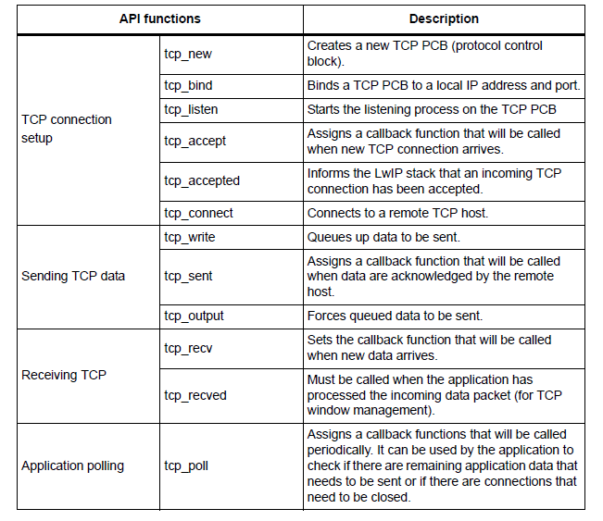
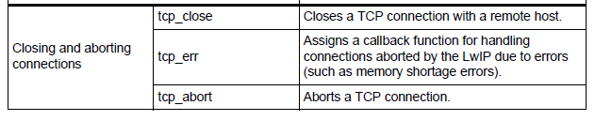
Middleware: LwIP
Raw API
functions

Slide 40
Middleware: LwIP
The Netconn API is a high-level sequential API which model of execution is based on the blocking open-read-write-close paradigm.
To operate correctly, this API must run in a multithreaded operating mode implementing a dedicated thread for the LwIP TCP/IP stack and/or multiple threads for the application.
Netconn API

Slide 41
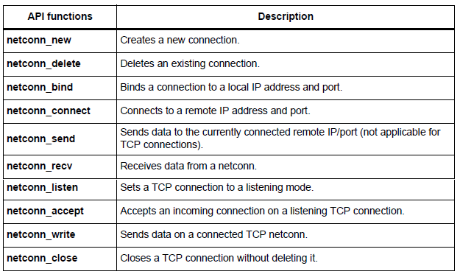
Middleware: LwIP
Netconn Functions

Slide 42
Middleware: LwIP
LwIP offers the standard BSD socket API. This is a sequential API which is internally built on top of the Netconn API
BSD Socket

Slide 43
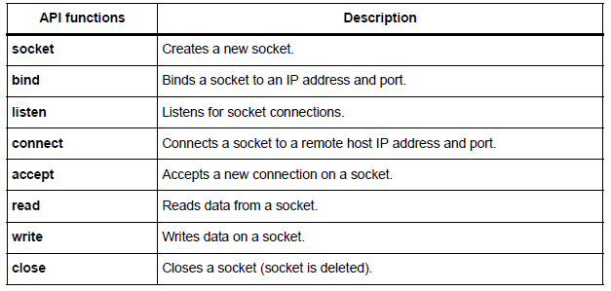
Middleware: LwIP
BSD Functions

Slide 44
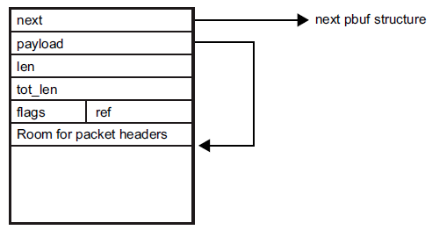
Middleware: LwIP
LwIP manages packet buffers using a data structure called pbuf. The pbuf structure enables the allocation of a dynamic memory to hold a packet content and lets packets reside in the static memory.
Pbufs can be linked together in a chain, thus enabling packets to span over several pbufs.
where
next contains the pointer to the next pbuf in a pbuf chain
payload contains the pointer to the packet data payload
len is the length of the data content of the pbuf
tot_len is the sum of pbuf len plus all the len fields of the next pbufs in the chain
ref is the 4-bit reference count that indicates the number of pointers that point to the pbuf. A pbuf can be released from memory only when its reference count is zero.
flags (on 4 bits) indicate the type of pbuf

Slide 45
Middleware: LwIP
LwIP defines three types of pbufs, depending on the allocation type:
PBUF_POOL pbuf allocation is performed from a pool of statically preallocated pbufs of predefined size. Depending on the data size that needs to be allocated, one or multiple chained pbufs are required.
PBUF_RAM pbuf is dynamically allocated in memory (one contiguous chunk of memory for the full pbuf)
PBUF_ROM No memory space allocation is required for user payload: the pbuf payload pointer points to data in ROM memory that can be used only for sending constant data.
For packet reception, the suitable pbuf type is PBUF_POOL. It allows to quickly allocate memory for the packet received from the pool of pbufs. Depending on the size of the received packet, one or multiple chained pbufs are allocated. The PBUF_RAM is not suitable for packet reception because dynamic allocation takes some delay. It may also lead to memory fragmentation.
For packet transmission, the user can choose the most suitable pbuf type according to the data to be transmitted,.

Slide 46
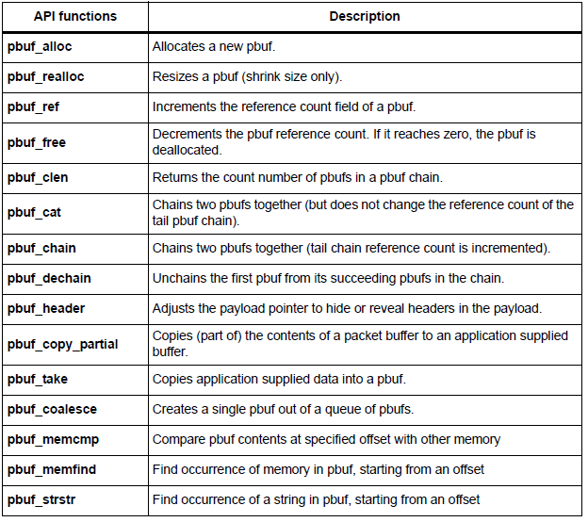
Middleware: LwIP
LwIP has a specific API for working with pbufs. This API is implemented in the pbuf.c core file.
Notes:
pbuf’ can be a single pbuf or a chain of pbufs.
When working with the Netconn API, netbufs (network buffers) are used for sending/receiving data.
A netbuf is simply a wrapper for a pbuf structure. It can accommodate both allocated and referenced data.
A dedicated API (implemented in file netbuf.c) is provided for managing netbufs (allocating, freeing, chaining, extracting data,...).

Slide 47
Interfacing LwIP with STM32Cube
This package includes two implementations:
Implementation without operating system (standalone)
Implementation with an operating system using CMSIS-RTOS API
For both implementations, the ethernetif.c file is used to link the LwIP stack to the STM32 Ethernet network interface.
The port of LwIP stack that must be connected to STM32F4xx/STM32F2x7xx is located in the “lwip/system” folder.
The Ethernet handle of the HAL (ETH_HandleTypeDef) should be declared in the ethernetif.c file, as well as the Ethernet DMA descriptors (ETH_DMADescTypeDef) and the Rx/Tx buffers of the Ethernet drive

Slide 48
Ethernet interface functions description
low_level_init
low_level_output
low_level_input
ethernet_input
ethernetif_init
Calls the Ethernet driver functions to initialize the STM32F4xx and STM32F2x7xx Ethernet peripheral
Calls the Ethernet driver functions to send an Ethernet packet
Calls the Ethernet driver functions to receive an Ethernet packet.
Initializes the network interface structure (netif) and calls low_level_init to initialize the Ethernet peripheral
Calls low_level_input to receive a packet then provide it to the LwIP stack

Slide 49
Example: how to initialize the Ethernet
static void low_level_init(struct netif *netif)
{
uint8_t macaddress[6]= {MAC_ADDR0, MAC_ADDR1, MAC_ADDR2, MAC_ADDR3, MAC_ADDR4, MAC_ADDR5};
EthHandle.Instance = ETH;
EthHandle.Init.MACAddr = macaddress;
EthHandle.Init.AutoNegotiation = ETH_AUTONEGOTIATION_ENABLE;
EthHandle.Init.Speed = ETH_SPEED_100M;
EthHandle.Init.DuplexMode = ETH_MODE_FULLDUPLEX;
EthHandle.Init.MediaInterface = ETH_MEDIA_INTERFACE_MII;
EthHandle.Init.RxMode = ETH_RXINTERRUPT_MODE;
EthHandle.Init.ChecksumMode = ETH_CHECKSUM_BY_HARDWARE;
EthHandle.Init.PhyAddress = DP83848_PHY_ADDRESS;
/* configure ethernet peripheral (GPIOs, clocks, MAC, DMA) */
HAL_ETH_Init(&EthHandle) ;
/* Initialize Tx Descriptors list: Chain Mode */
HAL_ETH_DMATxDescListInit(&EthHandle, DMATxDscrTab, &Tx_Buff[0][0], ETH_TXBUFNB);
/* Initialize Rx Descriptors list: Chain Mode */
HAL_ETH_DMARxDescListInit(&EthHandle, DMARxDscrTab, &Rx_Buff[0][0], ETH_RXBUFNB);
/* Enable MAC and DMA transmission and reception */
HAL_ETH_Start(&EthHandle);
}

Slide 50
Stand Alone vs RTOS
The ethernet_input() function implementation differs between standalone and RTOS modes:
In standalone applications, this function must be inserted into the main loop of the application to poll for any received packet.
In RTOS applications, this function is implemented as a thread waiting for a semaphore to handle a received packet. The semaphore is given when the Ethernet peripheral generates an interrupt for a received packet.
The ethernetif.c file also implements the Ethernet peripheral MSP routines for low layer initialization (GPIO, CLK …) and interrupts callbacks.
In case of RTOS implementation, an additional file is used (sys_arch.c). This file implements an emulation layer for the RTOS services (message passing through RTOS mailbox, semaphores, etc.). This file should be tailored according to the current RTOS, that is FreeRTOS for this package

Slide 51
LwIP configuration
LwIP provides a file named lwipopts.h that allows the user to fully configure the stack and all its modules. The user does not need to define all the LwIP options: if an option is not defined, a default value defined in opt.h file is used. Therefore, lwipopts.h provides a way to override much of the lwIP behavior.

Slide 52
LwIP configuration
Modules support
The user can choose the modules he needs for his application, so that the code size will be optimized by compiling only the selected features.
As an example, to disable UDP and enable DHCP, the following code must be implemented in lwipopts.h file:
/* Disable UDP */
#define LWIP_UDP 0
/* Enable DHCP */
#define LWIP_DHCP 1

Slide 53
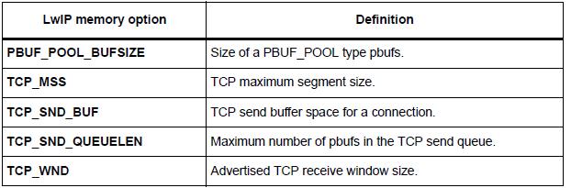
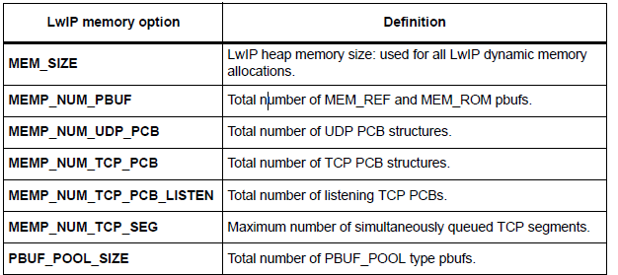
LwIP configuration
Memory Configuration
LwIP provides a flexible way to manage memory pool sizes and organization.
It reserves a fixed-size static memory area in the data segment. It is subdivided into the various pools that lwIP uses for the various data structures. As an example, there is a pool for struct tcp_pcb, and another pool for struct udp_pcb. Each pool can be configured to hold a fixed number of data structures. This number can be changed in the lwipopts.h file. For example, MEMP_NUM_TCP_PCB and MEMP_NUM_UDP_PCB define the maximum number of tcp_pcb and udb_pcb structures that can be active in the system at a given time.
The user options can be changed in lwipopts.h. the table below provides a summary of the main RAM memory options.

Slide 54
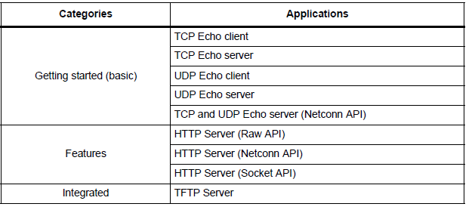
Using the LwIP apps
The STM32Cube LwIP package comes with several applications that use the different LwIP stack API sets.
The applications are divided into three categories as shown

Slide 55
Using the LwIP apps
We’ll have 2 examples during our hands on session
Getting started applications use the minimal configuration to run applications on top of the LwIP stack. LEDs are used to inform the user of application status.
Features applications provide more flexibility and options. They support network protocols like HTTP, DHCP and use LCD messages to indicate application status.
TCP echo client
This application is used to test a basic TCP connection
The STM32 MCU acts as a TCP client that connects to the TCP server
Web server based on raw API
This application implements a web server based on the LwIP raw API
It is used to connect to the STM32 MCU from a web client and to load HTML pages.

Slide 56

Hands on (at last! ☺)

Slide 57
Getting started applications
TCP echo client:
GOAL> Implement a basic TCP connection. The STM32 MCU acts as a TCP client that connects to the TCP server. The client sends a string and the server echoes back the same string to the client.
This is to happen every time the key button is pressed

Slide 58
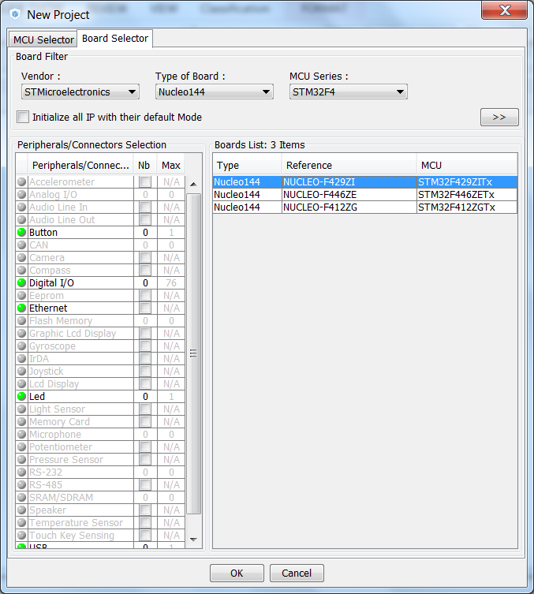
From Scratch
Open CubeMX and select the NUCLEO-F429ZI board:

Slide 59
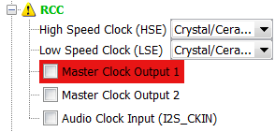
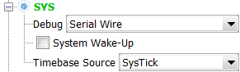
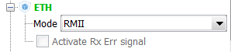
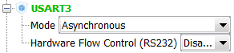
From Scratch
Let’s add the peripherals we’ll use
RCC
SYS
Ethernet
USART3

Slide 60
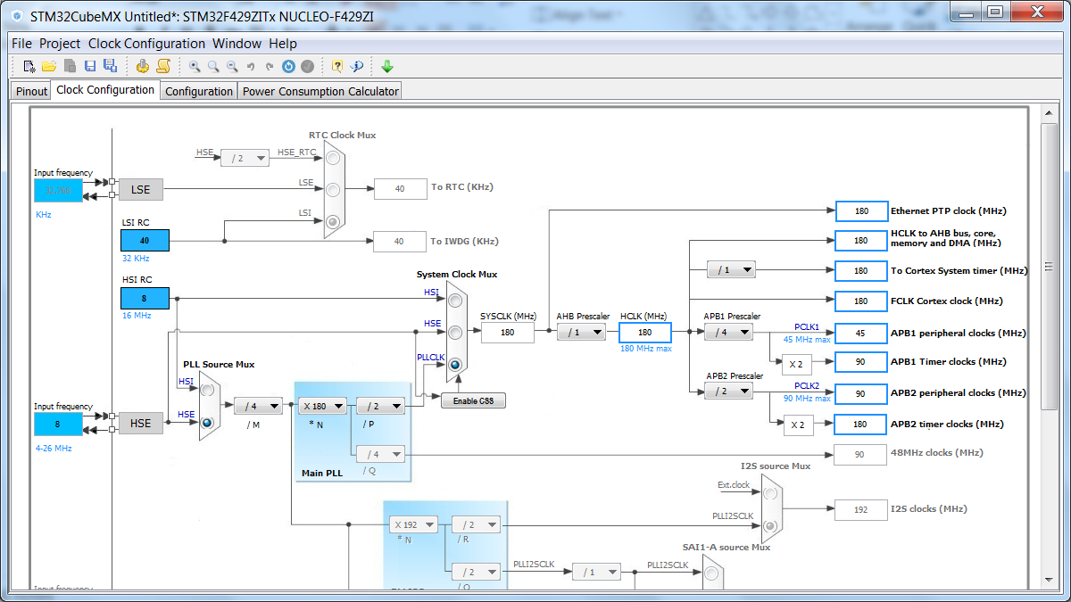
From Scratch
Configure the clock properly
Just let the Cube handle it at 180MHz

Slide 61
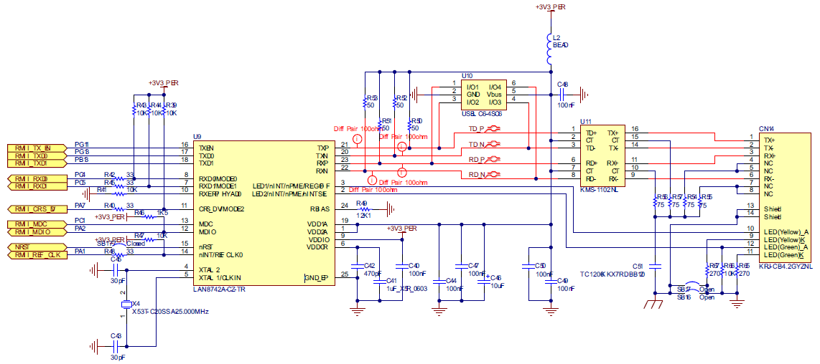
Ethernet
Most of the following setup will depend on the PHY
The eval kit uses the LAN8742a-cz
This PHY is a RMII type 10/100 Ethernet Transceiver

Slide 62
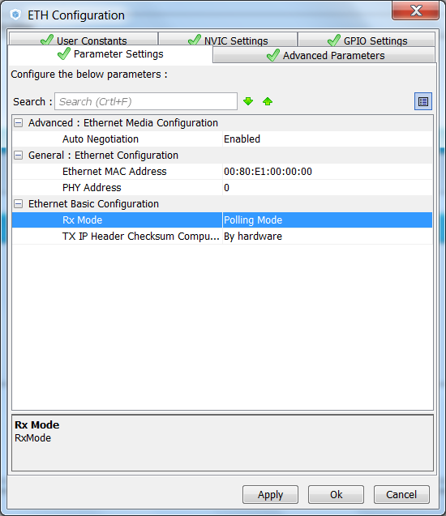
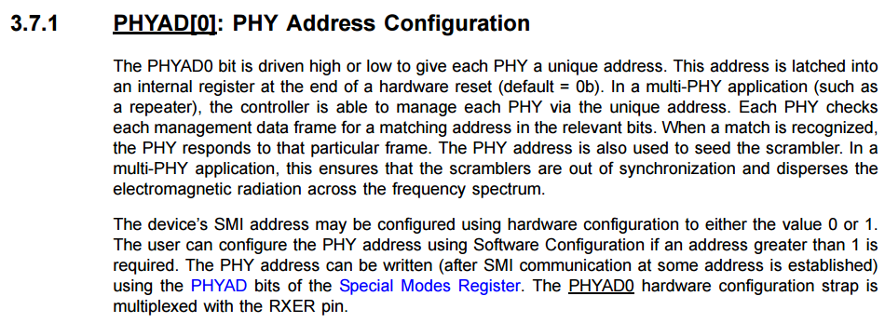
Ethernet
Ethernet Configuration:
Enable Rx Polling mode
Interrupt mode is only
available with RTOS
Change PHY address to 0
LAN8742A

Slide 63
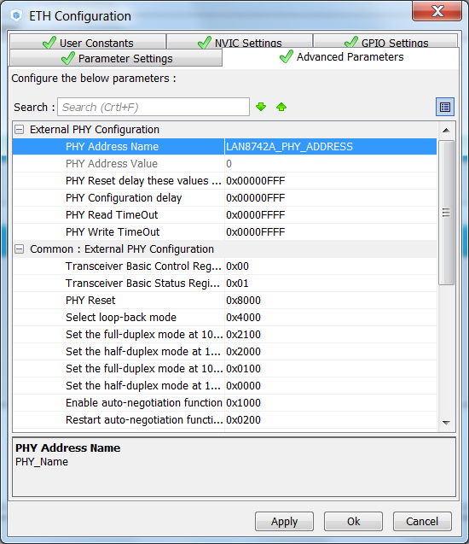
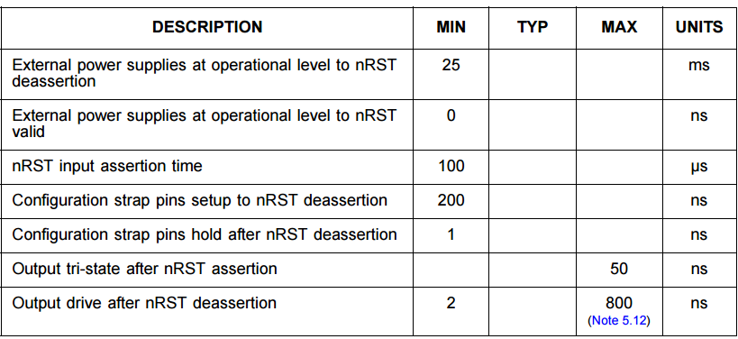
Ethernet
Ethernet advanced parameters

Slide 64
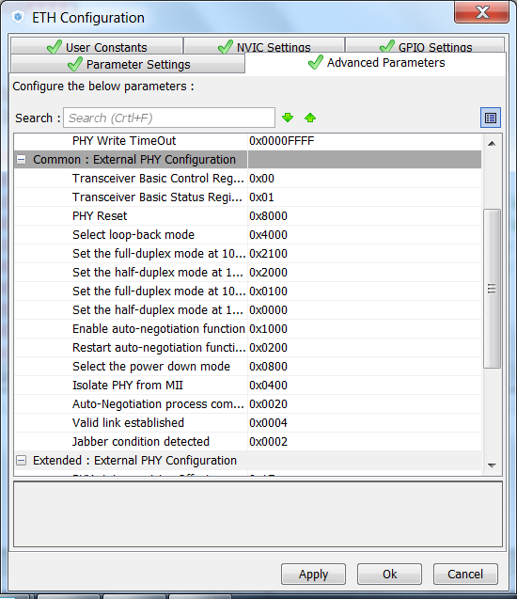
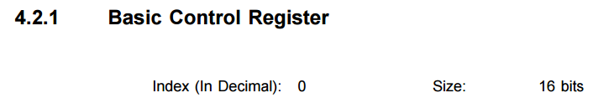
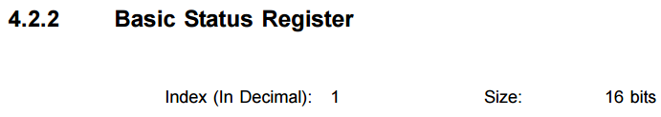
Ethernet
Ethernet advanced parameters

Slide 65
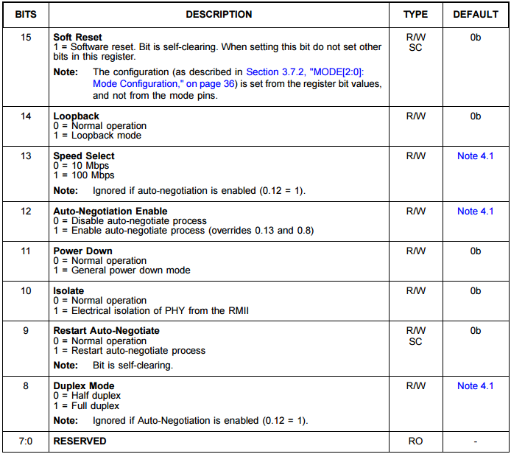
Ethernet
Ethernet advanced parameters

Slide 66
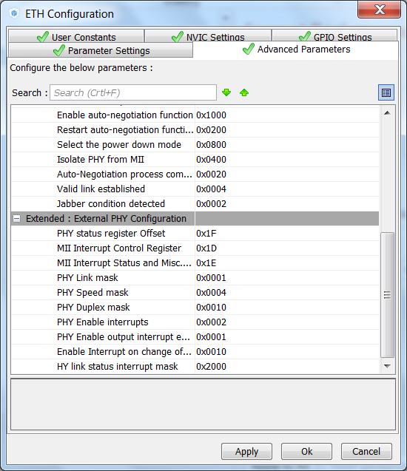
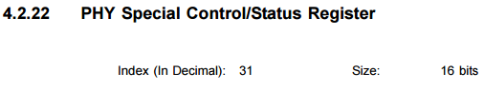
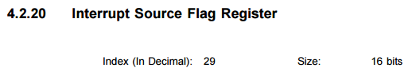
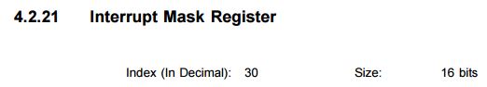
Ethernet
Ethernet advanced parameters

Slide 67
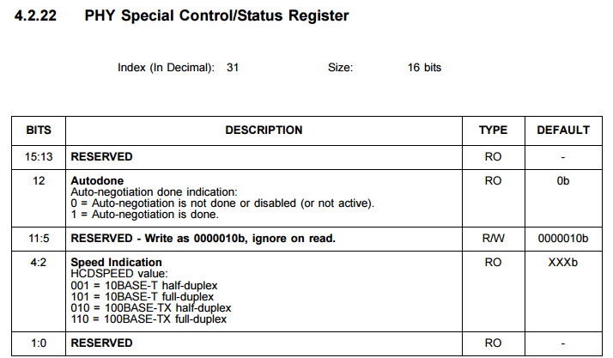
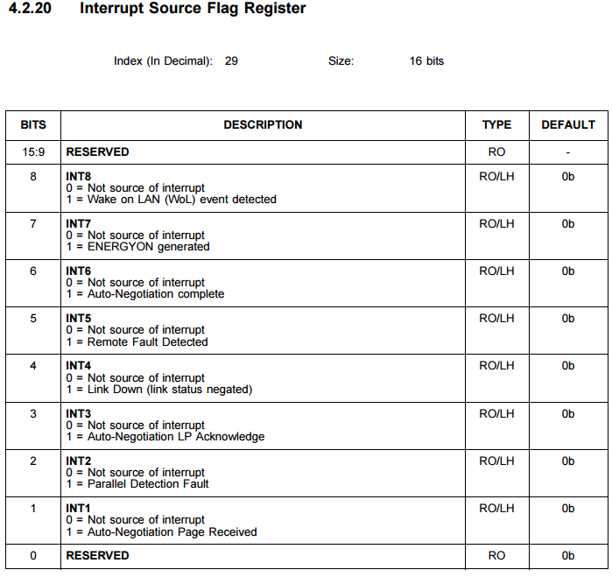
Ethernet
Ethernet advanced parameters

Slide 68
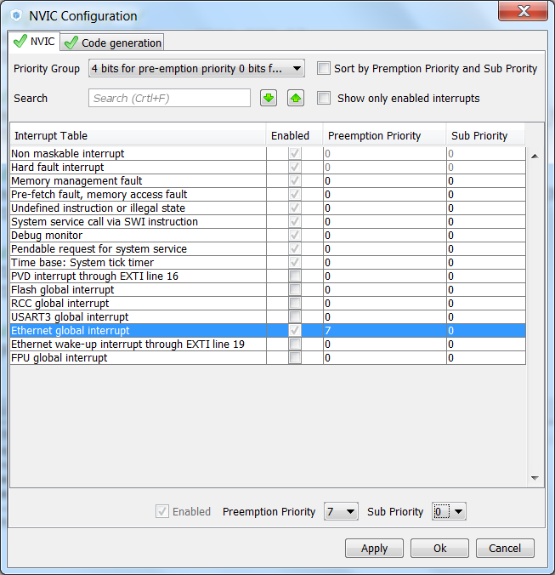
Ethernet
Change the Ethernet priority so it won’t interfeere with most of the application

Slide 69
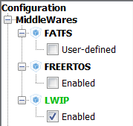
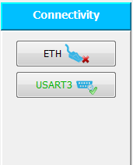
Ethernet
Middleware enable
Notice that the Ethernet will indicate error, ignore this for now

Slide 70
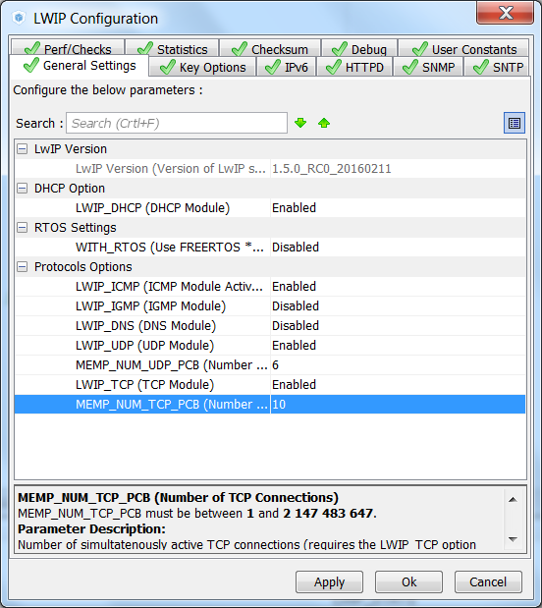
Ethernet
Middleware
Generic Setups
NO FreeRTOS
DHCP ENABLED

Slide 71
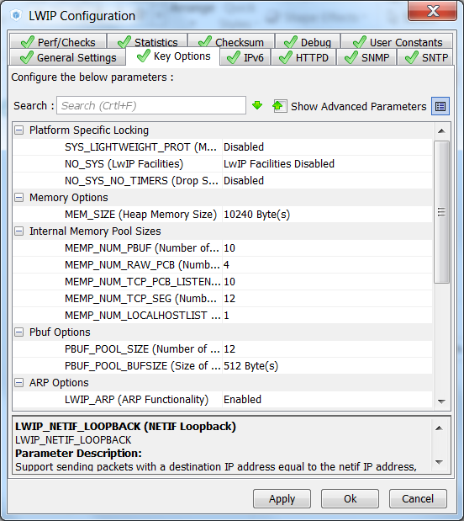
Ethernet
Middleware
Key Options
Memory Options
Memory Pool Sizes
Pbuf otions
ARP ENABLE

Slide 72
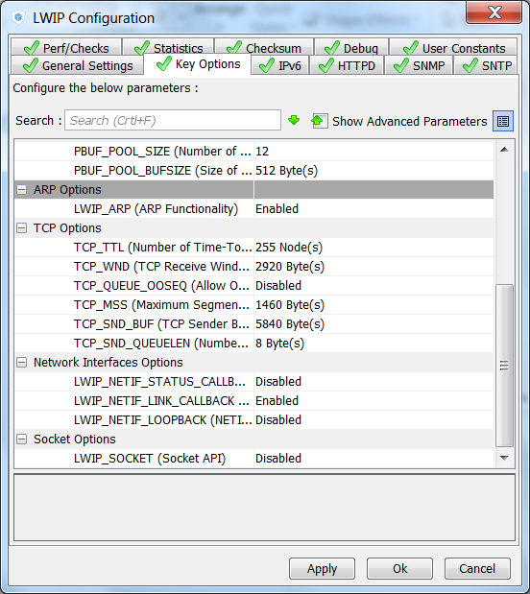
Ethernet
Middleware
Key Options
TCP Options
Network Interface
Socket Options

Slide 73
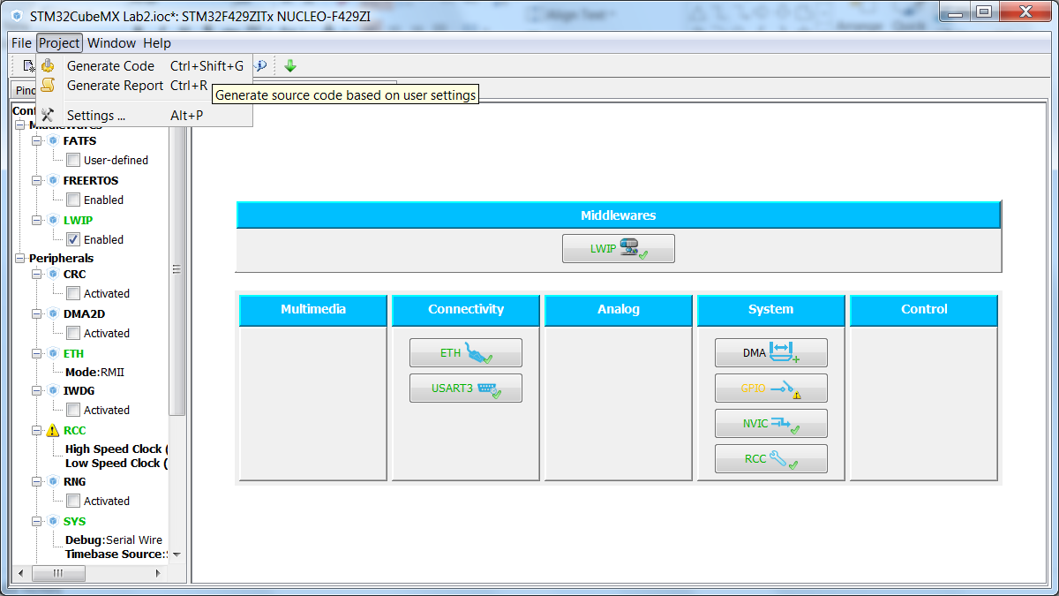
Generate the source code

Slide 74
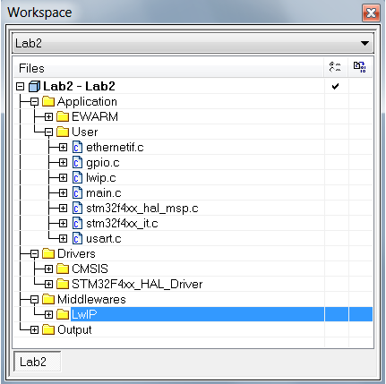
Edit the source generated
The project folders should look like this:

Slide 75
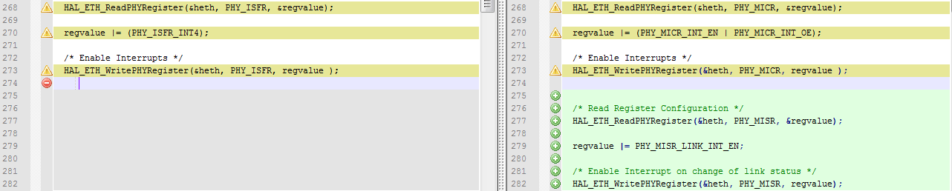
Edit the source generated
ethernetif.c
At line 268 to line 282
The left is how it should be
The right image is the one created automatically

Slide 76
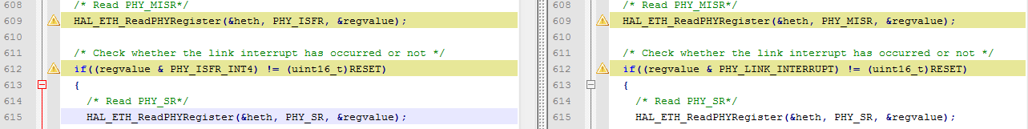
Edit the source generated
ethernetif.c
At line 609 to line 612
The left is how it should be
The right image is the one created automatically

Slide 77
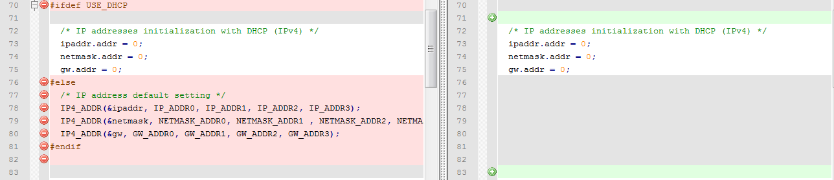
Edit the source generated
lwip.c
At line 70 to line 82
The left is how it should be
The right image is the one created automatically

Slide 78
Edit the source generated
lwip.c
At line 100 to line 104
The left is how it should be
The right image is the one created automatically

Slide 79
Edit the source generated
lwip.h
Let’s add the static IP and other features for the application
/* USER CODE BEGIN 0 */
#define DEST_IP_ADDR0 192
#define DEST_IP_ADDR1 168
#define DEST_IP_ADDR2 0
#define DEST_IP_ADDR3 11
#define DEST_PORT 7
/*Static IP ADDRESS: IP_ADDR0.IP_ADDR1.IP_ADDR2.IP_ADDR3 */
#define IP_ADDR0 192
#define IP_ADDR1 168
#define IP_ADDR2 0
#define IP_ADDR3 10
/*NETMASK*/
#define NETMASK_ADDR0 255
#define NETMASK_ADDR1 255
#define NETMASK_ADDR2 255
#define NETMASK_ADDR3 0
/*Gateway Address*/
#define GW_ADDR0 192
#define GW_ADDR1 168
#define GW_ADDR2 0
#define GW_ADDR3 1
/* USER CODE END 0 */

Slide 80
Edit the source generated
stm32f4xx_hal_conf.h
Let’s increase the oveall buffer size
Since Cube is flexible and can run MII PHY too, we’ll need to rename some registers to adjust for our RMII PHY
#define ETH_RXBUFNB ((uint32_t)5U) /* 4 Rx buffers of size ETH_RX_BUF_SIZE */
#define ETH_TXBUFNB ((uint32_t)5U) /* 4 Tx buffers of size ETH_TX_BUF_SIZE */
/* Section 4: Extended PHY Registers */
#define PHY_SR ((uint16_t)0x1FU) /*!< PHY status register Offset */
#define PHY_LINK_STATUS ((uint16_t)0x0001U) /*!< PHY Link mask */
#define PHY_SPEED_STATUS ((uint16_t)0x0004U) /*!< PHY Speed mask */
#define PHY_DUPLEX_STATUS ((uint16_t)0x0010U) /*!< PHY Duplex mask */
#define PHY_ISFR ((uint16_t)0x001DU) /*!< Enable Interrupt on change of link status */
#define PHY_ISFR_INT4 ((uint16_t)0x0010U) /*!< PHY link status interrupt mask */
/* ################## SPI peripheral configuration ########################## */
/* CRC FEATURE: Use to activate CRC feature inside HAL SPI Driver
* Activated: CRC code is present inside driver
* Deactivated: CRC code cleaned from driver
*/
#define USE_SPI_CRC 1U

Slide 81
Create our application
main.c
Our application will be made here, so we’ll have a lot of new functions and includes to add
There is no modification from the source created from CubeMX
The following code can be copied from this presentation, since they are not an image ;)
/* USER CODE BEGIN Includes */
#include "lwip/debug.h"
#include "lwip/stats.h"
#include "lwip/tcp.h"
#include "lwip/memp.h"
#include <stdio.h>
#include <string.h>
/* USER CODE END Includes */

Slide 82
Create our application
main.c
/* USER CODE BEGIN PV */
/* Private variables ---------------------------------------------------------*/
extern struct netif gnetif;
u8_t recev_buf[50];
__IO uint32_t message_count=0;
u8_t data[100];
struct tcp_pcb *echoclient_pcb;
/* ECHO protocol states */
enum echoclient_states
{
ES_NOT_CONNECTED = 0,
ES_CONNECTED,
ES_RECEIVED,
ES_CLOSING,
};
/* structure to be passed as argument to the tcp callbacks */
struct echoclient
{
enum echoclient_states state; /* connection status */
struct tcp_pcb *pcb; /* pointer on the current tcp_pcb */
struct pbuf *p_tx; /* pointer on pbuf to be transmitted */
};
/* USER CODE END PV */

Slide 83
Create our application
main.c
/* USER CODE BEGIN PFP */
/* Private function prototypes -----------------------------------------------*/
void User_notification(struct netif *netif);
void tcp_echoclient_connect(void);
static err_t tcp_echoclient_recv(void *arg, struct tcp_pcb *tpcb, struct pbuf *p, err_t err);
static void tcp_echoclient_connection_close(struct tcp_pcb *tpcb, struct echoclient * es);
static err_t tcp_echoclient_poll(void *arg, struct tcp_pcb *tpcb);
static err_t tcp_echoclient_sent(void *arg, struct tcp_pcb *tpcb, u16_t len);
static void tcp_echoclient_send(struct tcp_pcb *tpcb, struct echoclient * es);
static err_t tcp_echoclient_connected(void *arg, struct tcp_pcb *tpcb, err_t err);
/* USER CODE END PFP */

Slide 84
Create our application
main.c
/* USER CODE BEGIN 2 */
/* Notify user about the network interface config */
User_notification(&gnetif);
ethernetif_set_link(&gnetif);
/* USER CODE END 2 */

Slide 85
Create our application
main.c
/* USER CODE BEGIN 3 */
/* Read a received packet from the Ethernet buffers and send it
to the lwIP for handling */
ethernetif_input(&gnetif);
/* Handle timeouts */
sys_check_timeouts();
if (HAL_GPIO_ReadPin(GPIOC,GPIO_PIN_13) == GPIO_PIN_SET)
{
HAL_GPIO_WritePin(GPIOB,GPIO_PIN_14, GPIO_PIN_SET);
/*connect to tcp server */
tcp_echoclient_connect();
HAL_GPIO_WritePin(GPIOB,GPIO_PIN_14, GPIO_PIN_RESET);
while(HAL_GPIO_ReadPin(GPIOC,GPIO_PIN_13) == GPIO_PIN_SET);
HAL_Delay(200);
}
}
/* USER CODE END 3 */

Slide 86
Create our application
main.c
From here on, all the functions are to be placed under the comment section:
USER CODE BEGIN 4
/* USER CODE BEGIN 4 */
/**
* @brief Notify the User about the nework interface config status
* @param netif: the network interface
* @retval None
*/
void User_notification(struct netif *netif)
{
if (netif_is_up(netif))
{
/* Turn On LED 2 to indicate ETH and LwIP init success*/
HAL_GPIO_WritePin(GPIOB,GPIO_PIN_7, GPIO_PIN_SET);
}
else
{
/* Turn On LED 3 to indicate ETH and LwIP init error */
HAL_GPIO_WritePin(GPIOB,GPIO_PIN_14, GPIO_PIN_SET);
while(1);
}
}

Slide 87
Create our application
main.c
From here on, all the functions are to be placed under the comment section:
USER CODE BEGIN 4
/**
* @brief Connects to the TCP echo server
* @param None
* @retval None
*/
void tcp_echoclient_connect(void)
{
ip_addr_t DestIPaddr;
/* create new tcp pcb */
echoclient_pcb = tcp_new();
if (echoclient_pcb != NULL)
{
IP4_ADDR( &DestIPaddr, DEST_IP_ADDR0, DEST_IP_ADDR1, DEST_IP_ADDR2, DEST_IP_ADDR3 );
/* connect to destination address/port */
tcp_connect(echoclient_pcb,&DestIPaddr,DEST_PORT,tcp_echoclient_connected);
}
}

Slide 88
Create our application
main.c
From here on, all the functions are to be placed under the comment section:
USER CODE BEGIN 4 - continue the same function at the next slide
/**
* @brief Function called when TCP connection established
* @param tpcb: pointer on the connection contol block
* @param err: when connection correctly established err should be ERR_OK
* @retval err_t: returned error
*/
static err_t tcp_echoclient_connected(void *arg, struct tcp_pcb *tpcb, err_t err)
{
struct echoclient *es = NULL;
if (err == ERR_OK)
{
/* allocate structure es to maintain tcp connection informations */
es = (struct echoclient *)mem_malloc(sizeof(struct echoclient));
if (es != NULL)
{
es->state = ES_CONNECTED;
es->pcb = tpcb;
sprintf((char*)data, "sending tcp client message %d", (int)message_count);
/* allocate pbuf */
es->p_tx = pbuf_alloc(PBUF_TRANSPORT, strlen((char*)data) , PBUF_POOL);
if (es->p_tx)
{
/* copy data to pbuf */
pbuf_take(es->p_tx, (char*)data, strlen((char*)data));
Message is set here

Slide 89
Create our application
Cont. function from previous slide
/* pass newly allocated es structure as argument to tpcb */
tcp_arg(tpcb, es);
/* initialize LwIP tcp_recv callback function */
tcp_recv(tpcb, tcp_echoclient_recv);
/* initialize LwIP tcp_sent callback function */
tcp_sent(tpcb, tcp_echoclient_sent);
/* initialize LwIP tcp_poll callback function */
tcp_poll(tpcb, tcp_echoclient_poll, 1);
/* send data */
tcp_echoclient_send(tpcb,es);
return ERR_OK;
}
}
else
{
/* close connection */
tcp_echoclient_connection_close(tpcb, es);
/* return memory allocation error */
return ERR_MEM;
}
}
else
{
/* close connection */
tcp_echoclient_connection_close(tpcb, es);
}
return err;
}

Slide 90
Create our application
main.c
From here on, all the functions are to be placed under the comment section:
USER CODE BEGIN 4 - continue the same function at the next slide
/**
* @brief tcp_receiv callback
* @param arg: argument to be passed to receive callback
* @param tpcb: tcp connection control block
* @param err: receive error code
* @retval err_t: retuned error
*/
static err_t tcp_echoclient_recv(void *arg, struct tcp_pcb *tpcb, struct pbuf *p, err_t err)
{
struct echoclient *es;
err_t ret_err;
LWIP_ASSERT("arg != NULL",arg != NULL);
es = (struct echoclient *)arg;
/* if we receive an empty tcp frame from server => close connection */
if (p == NULL)
{
/* remote host closed connection */
es->state = ES_CLOSING;

Slide 91
Create our application
Cont. function from previous slide
if(es->p_tx == NULL)
{
/* we're done sending, close connection */
tcp_echoclient_connection_close(tpcb, es);
}
else
{
/* send remaining data*/
tcp_echoclient_send(tpcb, es);
}
ret_err = ERR_OK;
}
/* else : a non empty frame was received from echo server but for some reason err != ERR_OK */
else if(err != ERR_OK)
{
/* free received pbuf*/
if (p != NULL)
{
pbuf_free(p);
}
ret_err = err;
}
else if(es->state == ES_CONNECTED)
{
/* increment message count */
message_count++;
/* Acknowledge data reception */
tcp_recved(tpcb, p->tot_len);
pbuf_free(p);
tcp_echoclient_connection_close(tpcb, es);
ret_err = ERR_OK;
}
/* data received when connection already closed */
else
{
/* Acknowledge data reception */
tcp_recved(tpcb, p->tot_len);
/* free pbuf and do nothing */
pbuf_free(p);
ret_err = ERR_OK;
}
return ret_err;
}

Slide 92
Create our application
main.c
From here on, all the functions are to be placed under the comment section:
USER CODE BEGIN 4 - continue the same function at the next slide
/**
* @brief function used to send data
* @param tpcb: tcp control block
* @param es: pointer on structure of type echoclient containing info on data
* to be sent
* @retval None
*/
static void tcp_echoclient_send(struct tcp_pcb *tpcb, struct echoclient * es)
{
struct pbuf *ptr;
err_t wr_err = ERR_OK;
while ((wr_err == ERR_OK) &&
(es->p_tx != NULL) &&
(es->p_tx->len <= tcp_sndbuf(tpcb)))
{
/* get pointer on pbuf from es structure */
ptr = es->p_tx;
/* enqueue data for transmission */
wr_err = tcp_write(tpcb, ptr->payload, ptr->len, 1);
if (wr_err == ERR_OK)
{
/* continue with next pbuf in chain (if any) */
es->p_tx = ptr->next;

Slide 93
Create our application
Cont. function from previous slide
if(es->p_tx != NULL)
{
/* increment reference count for es->p */
pbuf_ref(es->p_tx);
}
/* free pbuf: will free pbufs up to es->p (because es->p has a reference count > 0) */
pbuf_free(ptr);
}
else if(wr_err == ERR_MEM)
{
/* we are low on memory, try later, defer to poll */
es->p_tx = ptr;
}
else
{
/* other problem ?? */
}
}
}

Slide 94
Create our application
main.c
From here on, all the functions are to be placed under the comment section:
USER CODE BEGIN 4 - continue the same function at the next slide
/**
* @brief This function implements the tcp_poll callback function
* @param arg: pointer on argument passed to callback
* @param tpcb: tcp connection control block
* @retval err_t: error code
*/
static err_t tcp_echoclient_poll(void *arg, struct tcp_pcb *tpcb)
{
err_t ret_err;
struct echoclient *es;
es = (struct echoclient*)arg;
if (es != NULL)
{
if (es->p_tx != NULL)
{
/* there is a remaining pbuf (chain) , try to send data */
tcp_echoclient_send(tpcb, es);
}
else
{

Slide 95
Create our application
Cont. function from previous slide
/* no remaining pbuf (chain) */
if(es->state == ES_CLOSING)
{
/* close tcp connection */
tcp_echoclient_connection_close(tpcb, es);
}
}
ret_err = ERR_OK;
}
else
{
/* nothing to be done */
tcp_abort(tpcb);
ret_err = ERR_ABRT;
}
return ret_err;
}

Slide 96
Create our application
main.c
From here on, all the functions are to be placed under the comment section:
USER CODE BEGIN 4 - continue the same function at the next slide
/**
* @brief This function implements the tcp_sent LwIP callback (called when ACK
* is received from remote host for sent data)
* @param arg: pointer on argument passed to callback
* @param tcp_pcb: tcp connection control block
* @param len: length of data sent
* @retval err_t: returned error code
*/
static err_t tcp_echoclient_sent(void *arg, struct tcp_pcb *tpcb, u16_t len)
{
struct echoclient *es;
LWIP_UNUSED_ARG(len);
es = (struct echoclient *)arg;
if(es->p_tx != NULL)
{
/* still got pbufs to send */
tcp_echoclient_send(tpcb, es);
}
return ERR_OK;
}

Slide 97
Create our application
main.c
Last function
/**
* @brief This function notify user about link status changement.
* @param netif: the network interface
* @retval None
*/
void ethernetif_notify_conn_changed(struct netif *netif)
{
ip_addr_t ipaddr;
ip_addr_t netmask;
ip_addr_t gw;
if(netif_is_link_up(netif))
{
IP4_ADDR(&ipaddr, IP_ADDR0, IP_ADDR1, IP_ADDR2, IP_ADDR3);
IP4_ADDR(&netmask, NETMASK_ADDR0, NETMASK_ADDR1 , NETMASK_ADDR2, NETMASK_ADDR3);
IP4_ADDR(&gw, GW_ADDR0, GW_ADDR1, GW_ADDR2, GW_ADDR3);
netif_set_addr(netif, &ipaddr , &netmask, &gw);
/* When the netif is fully configured this function must be called.*/
netif_set_up(netif);
}
else
{
/* When the netif link is down this function must be called.*/
netif_set_down(netif);
}
}
/* USER CODE END 4 */

Slide 98
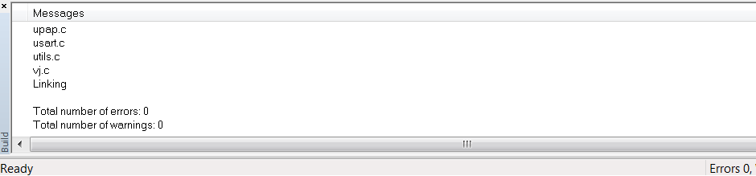
The moment of truth
Compile the project
We expect 0 erros and 0 warnings

Slide 99
How to test it?
To test the TCP echo client application, follow these steps:
Build and program the code we’ve just made - LEDs indicates the LwIP initialization success or failure (the dynamic address allocation “DHCP” is not supported for this application).
On the remote PC, open a command prompt window. Under Windows, select Start > All Programs > Accessories > Command Prompt.
At the command prompt, enter:
C:\>echotool /p tcp /s
When the Key button is pressed on the kit, the client sends a string and the server echoes back the same string to the client
Make sure the remote PC IP address is identical to the address defined in the main.h file (192.168.0.11 by default).

Slide 100


How to test it?
Depending on the firewall in your PC, you may need to manually change the IP address:

Slide 101

How to test it?
The terminal message should be like this:

Slide 102
Hands on

Slide 103
Features applications
Web server based on raw API:
GOAL> Implements a web server based on the LwIP raw API. It is used to connect to the STM32 MCU from a web client and to load HTML pages
The web server application implements the following features:
URL parsing
CGI (Common Gateway Interface)
SSI (Server Side Includes)
Dynamic Header generation
HTTP Post request

Slide 104

CubeMX
For this application, we’ll use the static IP
IP ADDR: 192.168.0.10
NETMASK: 255.255.255.0
GATEWAY: 192.168.0.1

Slide 105

Under LWIP Configuration
In order o run the HTTP server, it’s needed to add the HTTPD feature

Slide 106
Sad Note
LWIP_HTTPD (LwIP HTTPD Support ** CubeMX specific **) LWIP_HTTPD
Parameter Description:
Warning: This parameter introduced by CubeMX is not part of LwIP stack. Enable HTTPD requires user specific code not yet generated by STM32Cube MX. This is reserved for advanced users.
Note: All other HTTPD options are visible as "Advanced Parameters" and only when LWIP_HTTPD is enabled.

Slide 107
Sad Note
This httpd supports for a rudimentary server-side-include facility which will replace tags of the form in any file whose extension is .shtml, .shtm or .ssi with strings provided by an include handler whose pointer is provided to the module via function http_set_ssi_handler(). Additionally, a simple common gateway interface (CGI) handling mechanism has been added to allow clients to hook functions to particular request URIs. To enable SSI support, define label LWIP_HTTPD_SSI in lwipopts.h. To enable CGI support, define label LWIP_HTTPD_CGI in lwipopts.h.

Slide 108
Sad Note
By default, the server assumes that HTTP headers are already present in each file stored in the file system. By defining LWIP_HTTPD_DYNAMIC_HEADERS in lwipopts.h, this behavior can be changed such that the server inserts the headers automatically based on the extension of the file being served. If this mode is used, be careful to ensure that the file system image used does not already contain the header information. File system images without headers can be created using the makefsfile tool with the -h command line option.

Slide 109
Sad Note
Notes about valid SSI tags:
The following assumptions are made about tags used in SSI markers: 1. No tag may contain '-' or whitespace characters within the tag name. 2. Whitespace is allowed between the tag leadin and the start of the tag name and between the tag name and the leadout string. 3. The maximum tag name length is LWIP_HTTPD_MAX_TAG_NAME_LEN, currently 8 characters.
Notes on CGI usage:
The simple CGI support offered here works with GET method requests only and can handle up to 16 parameters encoded into the URI. The handler function may not write directly to the HTTP output but must return a filename that the HTTP server will send to the browser as a response to the incoming CGI request.
The list of supported file types is quite short, so if makefsdata complains about an unknown extension, make sure to add it (and its doctype) to the 'g_psHTTPHeaders' list.

Slide 110


Let’s add the ADC
Add the ADC3 – Channel 7
The Pin is the PF9

Slide 111

Configure the ADC
Select Continuous mode and set the sampling hold time to 56 cycles

Slide 112
Generate the code
Just for the purpouse to have different Labs, save the configured Cube as a new Lab, in this case, Lab2 was used
Generate and open the project
Don’t try to build it yet

Slide 113
Edit the source generated
ethernetif.c
At line 268 to line 282
The left is how it should be
The right image is the one created automatically

Slide 114
Edit the source generated
ethernetif.c
At line 609 to line 612
The left is how it should be
The right image is the one created automatically

Slide 115
Edit the source generated
lwip.c
At line 70 to line 82
The left is how it should be
The right image is the one created automatically

Slide 116
Edit the source generated
stm32f4xx_hal_conf.h
Let’s increase the oveall buffer size
Since Cube is flexible and can run MII PHY too, we’ll need to rename some registers to adjust for our RMII PHY
#define ETH_RXBUFNB ((uint32_t)5U) /* 4 Rx buffers of size ETH_RX_BUF_SIZE */
#define ETH_TXBUFNB ((uint32_t)5U) /* 4 Tx buffers of size ETH_TX_BUF_SIZE */
/* Section 4: Extended PHY Registers */
#define PHY_SR ((uint16_t)0x1FU) /*!< PHY status register Offset */
#define PHY_LINK_STATUS ((uint16_t)0x0001U) /*!< PHY Link mask */
#define PHY_SPEED_STATUS ((uint16_t)0x0004U) /*!< PHY Speed mask */
#define PHY_DUPLEX_STATUS ((uint16_t)0x0010U) /*!< PHY Duplex mask */
#define PHY_ISFR ((uint16_t)0x001DU) /*!< Enable Interrupt on change of link status */
#define PHY_ISFR_INT4 ((uint16_t)0x0010U) /*!< PHY link status interrupt mask */
/* ################## SPI peripheral configuration ########################## */
/* CRC FEATURE: Use to activate CRC feature inside HAL SPI Driver
* Activated: CRC code is present inside driver
* Deactivated: CRC code cleaned from driver
*/
#define USE_SPI_CRC 1U

Slide 117

Create our application
The first step is to have the HTML files the server will have
Copy the “Fs” folder available to download here> https://github.com/Montanari9/Ethernet_training
This folder shold be copied into the workspace root folder

Slide 118


Create our application
The idea is to use a custom file, so some defines under the httpd_opts.h needs to be changed
httpd_opts.h

Slide 119


Create our application
With these changes, the file fs.c will request the custom file
This file needs to contain all binary images and HTML pages created, so they can be addressed in a vector model for reconstruction
The way the Middleware adds this .c file is by include
To enable this, the Preprocessor from IAR needs to be changed

Slide 120
Create our application
The additional source files needed for this application are available at the Src folder - repository > https://github.com/Montanari9/Ethernet_training
fsdata_custom.c
httpd_cgi_ssi.c
app_ethernet.c
http_cgi_ssi.h
app_ethernet.h

Slide 121

Makefsdata
The way to convert the html pages into the C vector, is to use the makefsdata.exe
There are 2 ways to create the file
Just run the executable with the Fs folder in the same structure
Run the executable using the cmd.exe and inform the directory the fs folder is

Slide 122

Create our Application
Add these files to the workspace
httpd_cgi_ssi.c
app_ethernet.c
The IDE should look like this

Slide 123
Create our Application
main.c
Our application will be called here, but this time it was made under the httpd_cgi_ssi.c file
There is no modification from the source created from CubeMX
The following code can be copied from this presentation, since they are not an image ;)
/* USER CODE BEGIN Includes */
#include "http_cgi_ssi.h"
#include "app_ethernet.h"
/* USER CODE END Includes */

Slide 124
Create our Application
main.c
/* USER CODE BEGIN 2 */
/* Http webserver Init */
http_server_init();
/* Notify user about the network interface config */
User_notification(&gnetif);
/* USER CODE END 2 */
/* Infinite loop */
/* USER CODE BEGIN WHILE */
while (1)
{
/* USER CODE END WHILE */
/* USER CODE BEGIN 3 */
/* Read a received packet from the Ethernet buffers and send it
to the lwIP for handling */
ethernetif_input(&gnetif);
/* Handle timeouts */
sys_check_timeouts();
}
/* USER CODE END 3 */

Slide 125
Create our Application
In order to properly use the gnetif in other files, we need to export the struct inside lwip.h
/* USER CODE BEGIN 1 */
/* Function defined in lwip.c to:
* - Read a received packet from the Ethernet buffers
* - Send it to the lwIP stack for handling
* - Handle timeouts if NO_SYS_NO_TIMERS not set
*/
void MX_LWIP_Process(void);
extern struct netif gnetif;
/* USER CODE END 1 */

Slide 126

Create our Application
At this point, a rebuild all should result in:

Slide 127
How to test it?
To test the web server application, follow these steps:
Build and program the application code as we’ve done
After an IP address has been assigned at 192.168.0.11 for the PC and 192.168.0.10 for the MCU we’ll be able to validate the web server
On the remote PC, open a web client (Mozilla Firefox. Google Chrome or Internet Explorer) and type the board IP address in a web browser.
192.168.0.10

Slide 128

How to test it?
The webserver home page is like this:

Slide 129
How to test it?
Server Side Includes (SSI)
The SSI is a method used to dynamically include dynamic data in HTML code.
This is done by placing a specific tag inside the HTML code of the web page. The tag should have the following format:
<!--#tag-->
For the ADC conversion page, the following tag is used inside the HTML code:
<!--#t-->
When there is a request for the ADC webpage (which has a “.shtml” extension), the server parses the webpage and when the tag is found, it is replaced by the ADC conversion value

Slide 130

How to test it?
ADC HTML page

Slide 131
How to test it?
Common Gateway Interface (CGI)
The CGI is a standard web technique used to execute a request coming from a client on the server side and then to return a response to the client.
In LwIP, the CGI offered works only with GET method requests and can handle up to 16 parameters encoded in the URI. The CGI handler function executed on the server side returns a HTML file that the HTTP server sends to the client.
In the HTTP server demonstration, this method is used to control the 3 LEDs (LED1, LED2 and LED3) of the evaluation board.

Slide 132

How to test it?
LED Control page

Slide 133
How to change the SSI and add a second tag?
In the HTML file responsible for the ADC update> STM32F4xxADC.shtml
We’ll add another tag “p”
Don’t forget to run the makefsdata.exe and change the fsdata_custom.c containt
<tr>
<td><small><span style="font-family: Verdana;">ADC
Converted Value</span> </small></td>
<td><!--#t--> <small><span style="font-family: Verdana;">mv</span></small> </td>
<td><!--#p--> <small><span style="font-family: Verdana;">mv</span></small> </td>
</tr>

Slide 134
How to change the SSI and add a second tag?
Change the httpd_cgi_ssi.c
Add the iIndex inside the ADC_Handler
Change the parameters from the ssi_handler inside the http_server_init
/* we will use character "t" and "p" as tag for CGI */
char const* TAGCHAR[2]={"t","p"};
char const** TAGS=&TAGCHAR[0];
if(iIndex == 1)
{
*(pcInsert + 0) = (char)(5+0x30);
*(pcInsert + 1) = (char)(6+0x30);
*(pcInsert + 2) = (char)(7+0x30);
*(pcInsert + 3) = (char)(8+0x30);
return 4;
}
/* configure SSI handlers (ADC page SSI) */
http_set_ssi_handler(ADC_Handler, (char const **)&TAGS[0], 2);

Slide 135
FAQ

Slide 136
FAQ
How do I choose between static or dynamic (DHCP) IP address allocation?
When the macro #define USE_DHCP located in main.h is commented, a static IP address is assigned to the STM32 microcontroller (by default 192.168.0.10, this value can be modified from “main.h” file).
If the macro #define USE_DHCP is uncommented, the DHCP protocol is enabled, and the STM32 will act as a DHCP client

Slide 137
FAQ
How does the application behave when the Ethernet cableis disconnected?
When the cable is disconnected the Ethernet peripheral stops both transmission and reception traffics and the network interface is shut down. If an LCD controller is used, a message is displayed to inform the user that the cable is not connected, otherwise the red LED of the evaluation board is switched on.
When the user re-connects the cable, the Ethernet traffic resumes and the network interface is set up. If an LCD controller is used, a message is displayed to inform the user of the new IP address either with static or dynamic allocation, otherwise the yellow LED of the evaluation board is switched on

Slide 138
FAQ
How can the application be ported on a different hardware?
When another hardware platform is used, check the GPIO configuration in the HAL_ETH_MspInit() function for the Ethernet peripheral and in HAL_PPP_MspInit() or HAL_MspInit() if the application needs more PPP peripheral.

Slide 139
Conclusion
LwIP package allows to use lwIP TCP/IP stack with the STM32Cube HAL API. This open source stack offers the services of a full-scale TCP/IP stack while keeping relatively low RAM/ROM usage.

Slide 140
Thank You
Notes:
THANK YOU

Slide 141


Content
Backup Slides
Precision Time Protocol
TCP-IP protocols
PHY selection
TCP-IP solutions
Notes:
We will start with the description of the Ethernet IP of the STM32F107, and present the Precision Time Protocol also called IEEE 1588.
Then we will go on with generic information about TCP-IP stack, its key protocols and also application layers protocols.
Then we will introduce the NicheLite TCP-IP stack from interniche. This is one software solution packaged by STMicroelectronics.
In the last part of this presentation I will provide some example of application, I will describe some HW configuration as well as a Software solution for each example.
ANIMATION
Let’s start with the hardware part with STM32F107 Ethernet.

Slide 142
Precision Time Protocol (IEEE1588) : How it works
Comparing the transmission of messages
From the master clock point of view
From the slave clock point of view
Master Clock
Slave Clock
Master Clock
Slave Clock
8
8
10
10
9
9
11
11
10
10
12
12
message
message
11
11
13
13
Propagation delay
Clocks Offset

Slide 143
Precision Time Protocol (IEEE1588) : How it works
Master Clock
Slave Clock
8
t1
10
Computation done
by the slave
PTP
9
A
11
A = t2 - t1 = Delay + Offset
10
t1
Sync message
12
B = t4 - t3 = Delay - Offset
11
Delay = (A + B)/2
Follow up
Message (t1)
t2
13
Offset = (A - B)/2
12
t4
14
13
This allow the Master and the slave to be synchronized with a sub-µsecond precision
Delay_Req message
B
t3
15
14
t4
16
Delay_Resp
Message (t4)
15
17
Propagation delay
16
Clocks Offset

Slide 144
Internet Protocol (IP)
IP
Checksum
Best Effort Delivery
Packets can be lost
Packets can be duplicated
Packets can be received in any order
The IP protocol can fragment and rebuild fragmented packets
127.127.127.127
UNORDERED
IP
DUPLICATED
Checksum
LOST
IP
IP
Checksum
C
127.127.127.127
IP
Checksum
127.127.127.127
IP
Checksum
127.127.127.127
A
Checksum
127.127.127.127
IP
A
Checksum
A
127.127.127.127
B
127.127.127.127
IP
IP
Data
Checksum
Checksum
Data
B
127.127.127.127
A
127.127.127.127
Notes:
IP : Internet Protocol
This protocol is one of the core protocols of the stack, most of the packets (TCP, UDP,ICMP, HTTP...) are transmitted using this protocol. IP provides a service to send data from one network entity to another entity that may be located on a distant network.
IP addresses are used to identify the source and destination devices.
While allowing to send data to devices over the networks, the IP protocol does not guaranty the delivery of these data, IP is a connectionless protocol
As shown above, IP datagrams can be lost, duplicated, or received in any order... It is a "best effort delivery" mechanism, the reliability of the communication (retransmission, reordering of the packets) is not handled at this layer.
The IP protocol can also fragment the data to be sent in different IP datagrams that will be re-assembled on the receiver’s side by the IP protocol.
The Key message here is that the packets can be lost, duplicated, or received in any order. IP is NOT a RELIABLE protocol.
Just like the post service, most of the time our postcard will arrive to our friends, but sometime it will be lost, some friends may received their postcard before others….

Slide 145
User Datagram Protocol (UDP)
A very simple datagram service
Relies on the IP protocol
Advantages :
simple,
Lightweight
Drawbacks:
A connectionless protocol (not reliable)
UDP
IP
Checksum
Checksum
Port 69
127.127.127.127
UNORDERED
DUPLICATED
UDP
LOST
UDP
Checksum
UDP
Checksum
C
127.127.127.127
UDP
Checksum
127.127.127.127
UDP
Checksum
Port Nb
A
Checksum
127.127.127.127
UDP
A
Checksum
A
Port Nb
B
Port Nb
Notes:
UDP : User Datagram Protocol
UDP is a simple datagram service allowing to send data over the network, it relies on IP.
The UDP packet is very simple, it contains an 8bytes header and the data. The header just add a source port and destination port number and the Checksum.
The UDP is a connectionless protocol and has he same drawbacks as the IP layer.
Packets can be lost
Packets can be duplicated
Packets can be received in any order (unordered)
It is still used by a lot of protocols and application. The UDP simplicity is an advantage for application where the upper layers already implement mechanism to ensure the reliability, or for protocols that doesn't require this reliability.

Slide 146
Transmission Control Protocol (TCP)
TCP
Connection Oriented Protocol (reliable) :
Based on the IP protocol
An acknowledge mechanism between the sender and the receiver
A mechanism to discard duplicated packets
A reordering mechanism
Checksum
Port 80
IP
Checksum
127.127.127.127
DUPLICATED
TCP
TCP
RE ORDERED
LOST
Checksum
UNORDERED
Checksum
Port Nb
Port Nb
A
TCP
TCP
Checksum
Checksum
127.127.127.127
TCP
TCP
A
TCP
127.127.127.127
TCP
C
Checksum
Checksum
DISCARDED
Checksum
RESEND
Checksum
B
127.127.127.127
TCP
Port Nb
Port Nb
127.127.127.127
TCP
A
A
Checksum
Checksum
Port Nb
C
B
Port Nb
Notes:
TCP : Transmission Control Protocol
The transmission protocol is one of the key element of Internet Protocol Suite, contrary to the IP and UDP protocols it provides a "connection oriented" service, allowing 2 devices on networks to have a reliable communication.
TCP relies on IP service for the transmission of the data over the networks.
This reliability is achieved with the following mechanisms being implemented in the TCP:
- A checksum to check the validity of the datagram like other protocols
- An acknowledge mechanism for the receiver to confirm to the sender the proper reception of a packet. If the sender does not received this acknowledge after a timeout it will resend the packet.
- If needed, the data to send over TCP will be split in segments, each segment being transmitted in a separate TCP packet, the receiver has a re-sequencing mechanism to reorder packets if they are received out of order.
- Duplicated packets are identified and discarded by the TCP protocol
- A TCP windows mechanism to allow a device to specify the buffer size available and prevent another device to send more data that it can handle.

Slide 147
Address Resolution Protocol (ARP)
IP
Checksum
Allow the TCP-IP stack to get the MAC address of the destination knowing its IP address
ARP is using Ethernet Frames to discover the Mac address.
127.127.127.127
?
ETHERNET
ARP
Checksum
Hello,
Who knows the MAC Address of
127.127.127.127 ?
?? MAC Address ??
ARP
Here I am,
my MAC Address is AA:BB:CC:DD:EE:FF
IP
Checksum
127.127.127.127
ETHERNET
ETHERNET
Checksum
Checksum
FF:FF:FF:FF:FF:FF
AA:BB:CC:DD:EE:FF
Notes:
ARP : Address Resolution Protocol
The ARP is also key element of the Internet protocol suite. As shown above, the IP only uses IP addresses to identify the source and destination, but the physical layer requires a MAC address to transmit the data.
The Address Resolution Protocol allows an emitting device to get the MAC address of the destination knowing its IP address.
Here is an introduction of how it works :
1) An ARP request is broadcasted on the local network (sent to all the devices) asking for the MAC address of 127.127.127.127
2) If on the network, 127.127.127.127 will reply to the sender it’s MAC address. If 127.127.127.127 is not on this network a router device may send its own MAC address.
3) The send now has the MAC address needed to send the IP datagram over the network.
This ARP requests and answers are sent by the stack itself, but the user application sometimes has to be aware of this mechanism (e.g. the API may return an "ARP request sent" kind of information)

Slide 148
Internet Control Message Protocol (ICMP)
The ICMP is a Key protocol of the Stack, as important as TCP, UCP and IP
It allows to communicate Queries and error messages
Some message can be sent by the user, other are send by the stack itself
Query (Ping)
Error Messages
ICMP
Echo Request
ICMP
Echo Reply
ICMP
Port
Unreachable
IP
Checksum
127.127.127.127
Notes:
ICMP : Internet Control Message Protocol
The ICMP protocol allows to communicate queries or error messages, it is actually a very important protocol often unknown.
One of the most used network command : the ping is indeed using the echo request and echo reply command of the ICMP protocol. This is an example of query that can be performed using ICMP.
This protocol can also be used to send error message, if you try to send a UDP datagram on the port 69 for example and the destination device that is not listening to this port, you may receive a “Port Unreachable” error sent by the destination device to inform you of the status.
The ICMP messages are encapsulated in a IP datagram for transmission.
This is a very important protocol of the TCP-IP stack, remove it and it will be a mess. It is like the traffic lights of internet.

Slide 149
Bootstrap protocol (BOOTP) / Dynamic Host Configuration Protocol (DHCP)
Can I
get an
IP address ?
to get an IP address from a configuration server
Relies on the UDP protocol
UDP
BOOTP
Checksum
DHCP
Ports 67/68
BOOTP | DHCP
Designed before DHCP | Designed after BOOTP
To configure diskless devices with limited boot capability | To configure frequently relocated network devices
Limited configuration parameters | Extended configuration parameters
… | …
Notes:
BOOTP : Bootstrap protocol
The Bootstrap protocol allows a device to get an IP address from a configuration server, it relies on the UDP service to operate.
This protocol for example was embedded in the BIOS of some network devices to allow these devices to boot from the network.
DHCP : Dynamic Host Configuration Protocol
The DHCP also offers some of the services of the bootp protocol, it allows a device to get an IP address from a configuration server.
Newer than the bootstrap protocol, the DHCP has more advanced features. Many devices now implement the DHCP client to retrieve an IP address, fewer device implement the server service that allocates the IP addresses.
One of the advanced feature of DHCP over BootP is the ability to allocate an IP address to a client for a limited time (the bootp allocation being unlimited). The DHCP supports the bootstrap protocol (BOOTP).

Slide 150
Domain Name Service (DNS)
www.st.com
It’s the “contact list” or “phone book” of the internet
It allows to resolve www.st.com into 81.25.196.35
IP
Checksum
?? IP Address ??
DNS
Where is www.st.com?
www.st.com
DNS
UDP
Try
81.25.196.35
Checksum
IP
Port 53
IP
Checksum
Checksum
DNS Server’s IP
81.25.196.35
Notes:
DNS : Domain Name Service
DNS is the Contact list or phone directory of the internet.
The DNS Client send a DNS request to a DNS server (over UDP and IP) as a response it will get the IP address of its target destination.
In the example here you see how to get the IP address of the ST portal. To simplify it is shown in a one step process, one request -> one IP address but practically this is done in several steps, several request being sent to several DNS server to get the IP address.

Slide 151
Trivial File Transfer Protocol (TFTP)
Server
Client
TFTP
Trivial File Transfer Protocol
Relies on UDP
Client / Server architecture
Implement a simple acknowledge mechanism
Advantages
Simple protocol
Can be implemented on memory constrained devices
TFTP
Acknowledge
File
TFTP
UDP
Checksum
Acknowledge
Port 69
Drawbacks :
Slow on high latency network
Notes:
TFTP : Trivial File Transfer Protocol
First defined in 1980, the TFTP protocol has a client/server architecture and allows file transfer over UDP using a simple mechanism allowing easy implementation on memory constrained devices.
To overcome the limitation of UDP that doesn't guaranty packet delivery, the receiver send an acknowledge packet after reception of a packet. Only one packet (either data or acknowlege) is sent over the network at a time reducing the performances compared to FTP protocol for example.
To summarize the main advantage of TFTP is its simplicity, the drawback being its performances on high latency network. This protocol can be used to download firmware.

Slide 152
File Transfer Protocol (FTP)
File Transfer Protocol
Relies on TCP
Client / Server architecture
Connection oriented inherited from TCP
Advantages
Several packets send simultaneously
More features (password protection, username…)
Client
Port 20
Server
FTP
Data
FTP
Port 21
Cmd
File
FTP
TCP
Checksum
Ports 20/21
Drawbacks :
More complex implementation
No encryption mechanism
Notes:
FTP : File Transfer Protocol
The FTP allows file transfer over the TCP protocol, and therefore inherit of his connection oriented characteristics.
It also takes advantage of the window mechanism and reordering abilities of the TCP protocol, so that several packets can be send over the network simultaneously increasing the performances. This client-server protocol uses 2 ports, one for the data, the other one for the control information.
FTP supports password based connection or anonymous users.
Please note that FTP doesn't include encryption mechanism, so the username and password are sent over the network in clear text.

Slide 153
Simple Mail Transfer Protocol (SMTP)
Simple Mail Transfer Protocol
Protocol to transmit electronic mails
Uses ASCII commands (plain text)
HELO or EHLO | Used by the client to identify itself
MAIL FROM: | Identifies the originator of the mail
RCPT TO: | Identifies the recipient of the message
DATA | Commands to send the content of the message
QUIT | To end the email exchange
Mail Server
IP
TCP
Checksum
HELO or EHLO
Checksum
SMTP
Port 25
Mail Server’s IP
Notes:
SMTP : Simple Mail Transfer Protocol
The SMTP is a standard protocol used to transmit electronic mails across the networks, it relies on the connection oriented TCP protocol.
Like most of the network protocols it has a client/server architecture.
It uses ASCII commands, making the frames more easy to understand. Each commands from the client is followed by and answer from the server.
Here are the commands supported by SMTP :
HELO or EHLO : commands used by the client to identify itself
MAIL FROM : Identifies the originator of the message
RCPT TO : Identifies the recipent of the message
DATA : Command used to send the content of the message
QUIT : Terminate the email exchange
The STMP is a protocol for transmitting email between devices always connected on the networks. It has no features for retrieving messages from a server (see POP3)

Slide 154
Post Office Protocol Version 3 (POP3)
My Emails
Post Office Protocol version 3
Used to retrieve email from an account on a server
No sending features
Mail Server
TCP
IP
My Email
Username
**Password**
Checksum
Checksum
POP3
Port 110
Mail Server’s IP
My Email
My Email
My Email
My Email
My Email
My Email
My Email
Notes:
POP3 : Post Office Protocol version 3
The POP3 (Post Office Protocol version 3) is a protocol designed to retrieve email from an account (mailbox) on a server (post office).
It has no features for sending messages to servers (see SMTP).

Slide 155
Simple Network Management Protocol (SNMP)
This protocol gives a framework for network management
SNMP has an agent/manager architecture:
The manager can ask agents some information
Agents can report some event to the manager
Agent
Get Request
SNMP
UDP
Checksum
Port 161
UDP
TRAP
I report some event
SNMP
Checksum
Port 162
Manager
Notes:
SNMP : Simple Network Management protocol
The networks are
- Bigger and bigger,
- More and more complex
- and more and more diverse (many different kind of device connected computer, server, printers….)
This protocol relies on UDP to offer a coherent framework to manage networks.
It is a client /server (also called agent/manager) architecture.
This protocol has a 2 way communication scheme :
the manager being able to ask the agent some information ( asking on the port 161 of the agent) ,
the agent being able as well to report some event (reporting it on the port 162 of the manager)

Slide 156

Hypertext Transfer Protocol (HTTP)
Used by the World Wide Web
It relies on the TCP protocol
Allows the client (a browser, …) to get ressources (html pages, pictures, …) from a server
HTTP
HTTP
GET (Request)
www.st.com/stm32
GET (Response)
TCP
Checksum
IP
Port 80
Checksum
Web Server’s IP
Notes:
HTTP : Hypertext Transfer Protocol
HTTP is the protocol used by the World Wide Web, it has a client server architecture and uses a request/response mechanism to operate.
Here is the sequence :
A connection is opened,
the HTTP client ( usually your browser) sends a request message to an HTTP server.
The server returns a response message that usually contains the requested resource (an html file for example).
The connection is then closed,
the HTTP protocol does not maintains the connection between transactions.

Slide 157

Remote Terminal Protocol (Telnet)
Provide a bidirectional communication service over the network
Telnet
******
Login
password?
Telnet
TCP
Checksum
IP
Port 23
Checksum
My IP
Notes:
Telnet : remote terminal protocol
The Telnet protocol get is name from Telecommunication network.
The purpose of this protocol is to provide a bidirectionnal communication service on the Internet or local area networks.
Telnet can be used to access a remote host with a terminal. The telnet rely on the connection oriented TCP protocol.

Slide 158
Point to Point Protocol (PPP)
IP
Checksum
IP address
A DataLink Layer
Encapsulates IP datagrams on serial line
Asynchronous links
Synchronous links
…
PPP
Checksum
Serial line
IP
Checksum
IP address
Notes:
PPP : Point to Point Protocol
The point to point protocol is a data-link layer protocol that allows the encapsulation of IP datagram on serial lines.
PPP supports:
asynchronous links with 8 bits of data and no parity
and synchronous links.
This protocol also defines a link control protocol to establish, configure and test the link for example, the LCP is used to automatically agree upon the encapsulation format options, or determine when a link is functioning....

Slide 159
Ethernet external PHYs brings great benefits
Re-use of PHY chips already qualified by customers.
RMII and MII supported on all connectivity line packages
Flexibility in selecting the robustness and temperature grade
Advanced power management with low power modes support
Industry best ESD and latch up performance supported by the PHY and also protecting the microcontroller.
Protects STM32F107
From ESD !
8kV HBM / 8kV/15kV IEC
ESD Protection ! ALL Pins
Magnetics
LAN 8700
LAN 8700 I
RJ45
STM32F107
MII / RMII
LAN 8700
ESD
No External ESD Protection Devices Required !
PHY List
Notes:
Here are some of the advantages of using an external PHY

Slide 160
Ethernet PHY chip offering from ST and others
Ethernet PHY Manufacturers | Part# | I/F supported | 50MHz Internal PLL | package | Size
ST | ST802RT1A Available in Q4 09 | MII/RMII/SMII | No | TQFP48 | 7x7
ST | STE100P | MII | No | TQFP64 | 10x10
National | DP83840TW | MII/RMII | Yes | LQFP48 | 7x7
National | DP83848CW | MII/RMII | No | LQFP48 | 7x7
Realtech | RTL8201N | MII/RMII | Yes | QFN or QFN32 (RMII only) | 9x9 or 5x5
Micrel | KSZ8721CL | MII/RMII | No | LQFP48 | 7x7
SMSC | LAN8700 | MII/RMII | No | QFN36 | 6x6
SMSC | LAN83C185 | MII | No | TQFP64 | 10x10
Marvell | 88E3015 | MII/RGMII | No | QFN56 | 8x8
Notes:
Here are some of the PHY that can be used with the STM32F107, other PHY can be used as well.

Slide 161






Ethernet software solutions from 3rd parties
Logo
Company
Product
Website
Interniche
NicheLite
www.iniche.com, www.st.com/mcu
IAR
PowerPac TCP/IP
www.iar.com, www.iar.com/st
Keil
RL-TCPnet
www.keil.com
Micrium
µC/TCP-IP
www.micrium.com, www.micrium.com/st/index.html
Micro Digital
smxNS
www.smxrtos.com, www.smxrtos.com/stmicro.htm
Quadros Systems
RTXC Quadnet
RTXC Quark
www.quadros.com
Segger
embOS/IP
www.segger.com
Notes:
This present some of the TCP-IP solutions on the market available for the STM32.

Slide 162

Network Setup

